Slide 1
Crime Data Analysis
Group 11:
Hari Khumar Prabakaran
Keerthana Ekambaram Ravichandran
Krithika Annaswamy Kannan
Pranav Kuramkote Sudhir
Prarthana Veerabhadraiah

Slide 2
Introduction to the Dataset
This dataset contains records of crime incidents in the City of Los Angeles, with data dating back to 2020.
The data is transcribed from original paper crime reports, and it may contain some inaccuracies or missing information.
Location information is rounded to the nearest hundred block to protect privacy.
The dataset is a valuable resource for analyzing crime patterns and trends in Los Angeles. - Key columns include Division of Records Number (DR_NO), date and time of reporting, date and time of occurrence (DATE OCC and TIME OCC), geographical coordinates (LAT and LON), crime codes (Crm Cd), and victim details (Vict Age, Vict Sex, Vict Descent).
Information on premises where the crime occurred, and the type of weapon used is also included.
The dataset is useful for law enforcement, policymakers, and researchers to make informed decisions regarding public safety.
Analysis of this dataset can reveal trends, patterns, and correlations in crime data over time.
Understanding potential limitations and data quality issues is essential due to the dataset's origin from paper records.

Slide 3
Problem Statement 1:
Overall Crime Trends:
Calculate and plot the total number of crimes per year to visualize the trends.

Slide 4
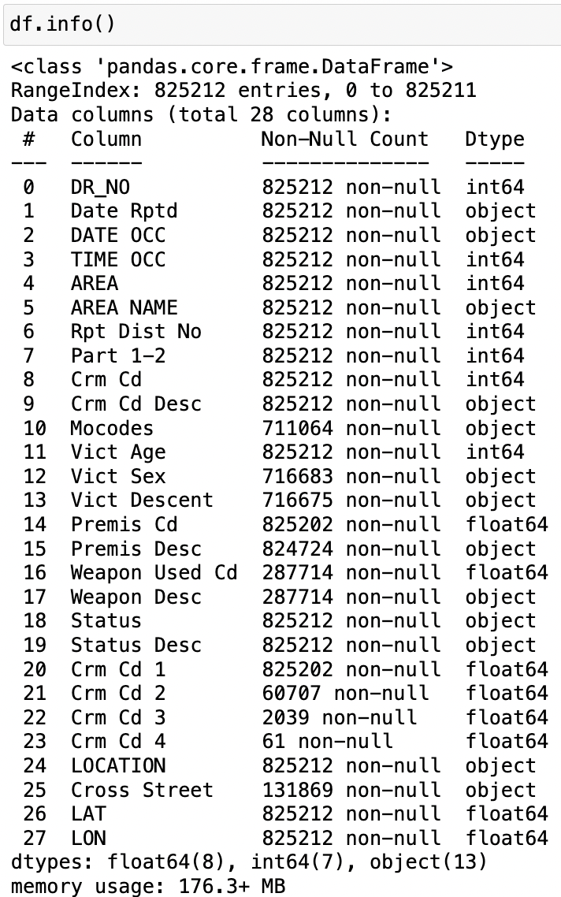
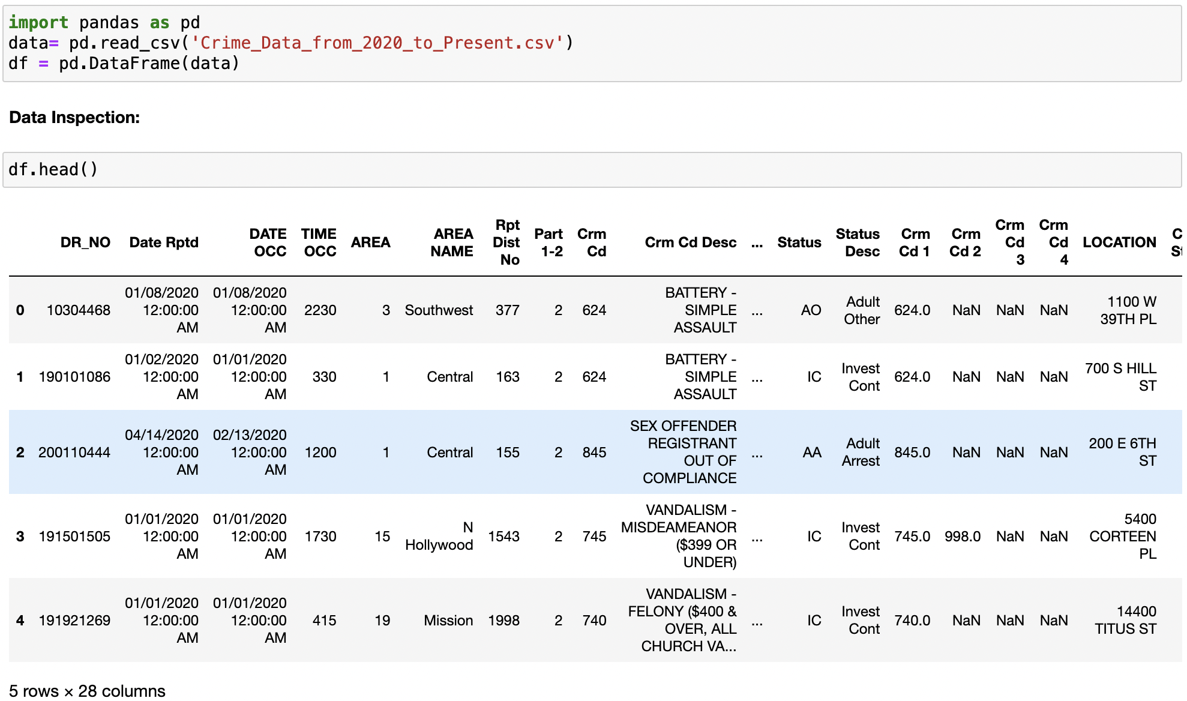
Data Acquisition and Data Inspection
Downloaded Crime data from this link.
Upload the data into data frame.
Displaying the first few rows and data types of each column.

Slide 5
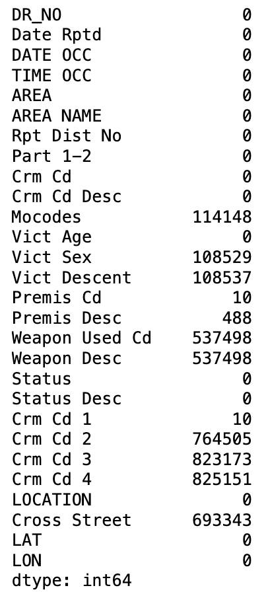
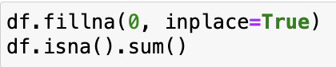
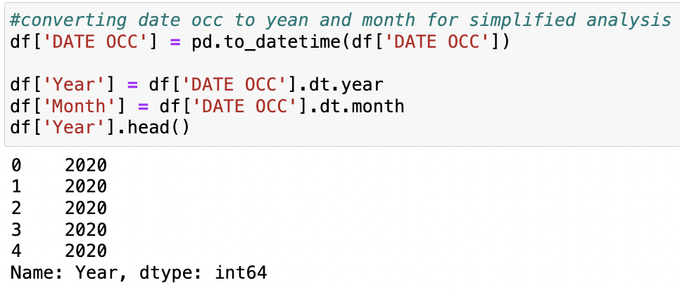
Data Cleaning
Checking for null values, and replacing them with 0, as it would be the best fit for this particular problem statement.
Converting date of occurrence into years and months, required.

Slide 6
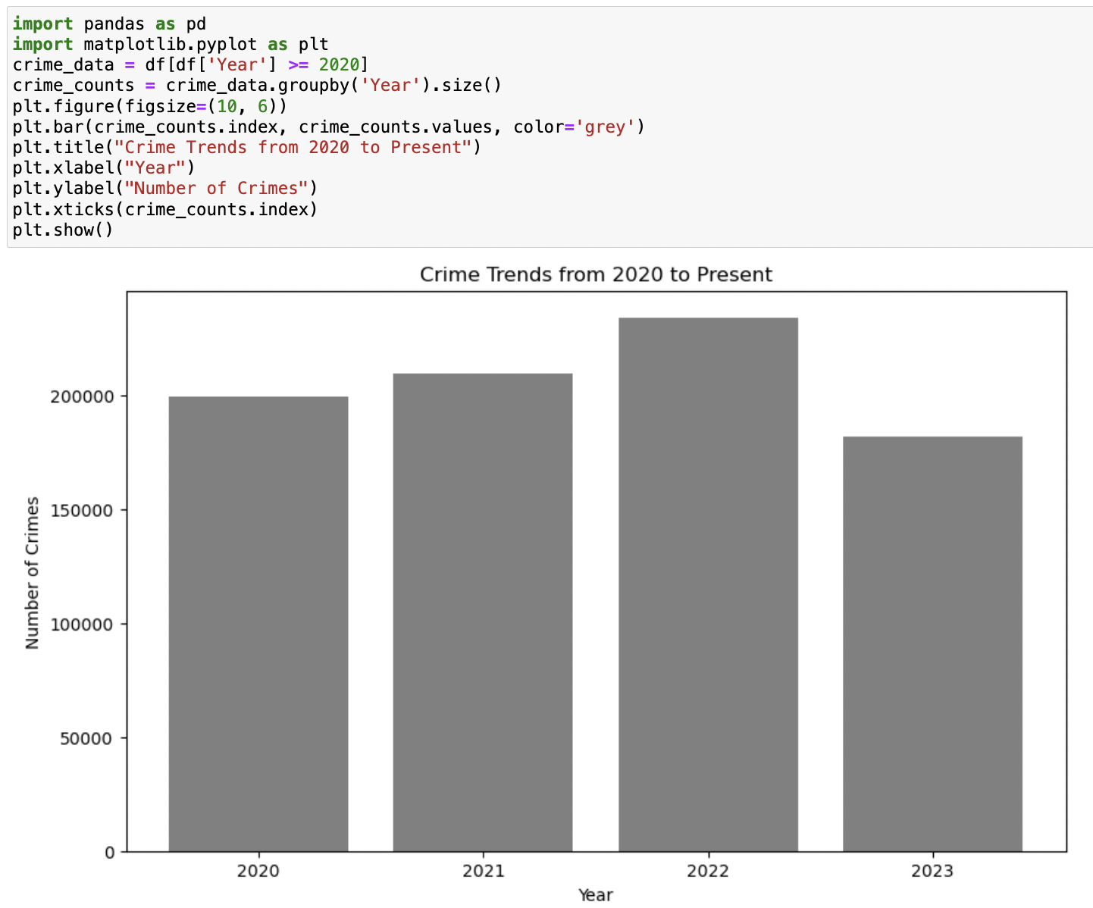
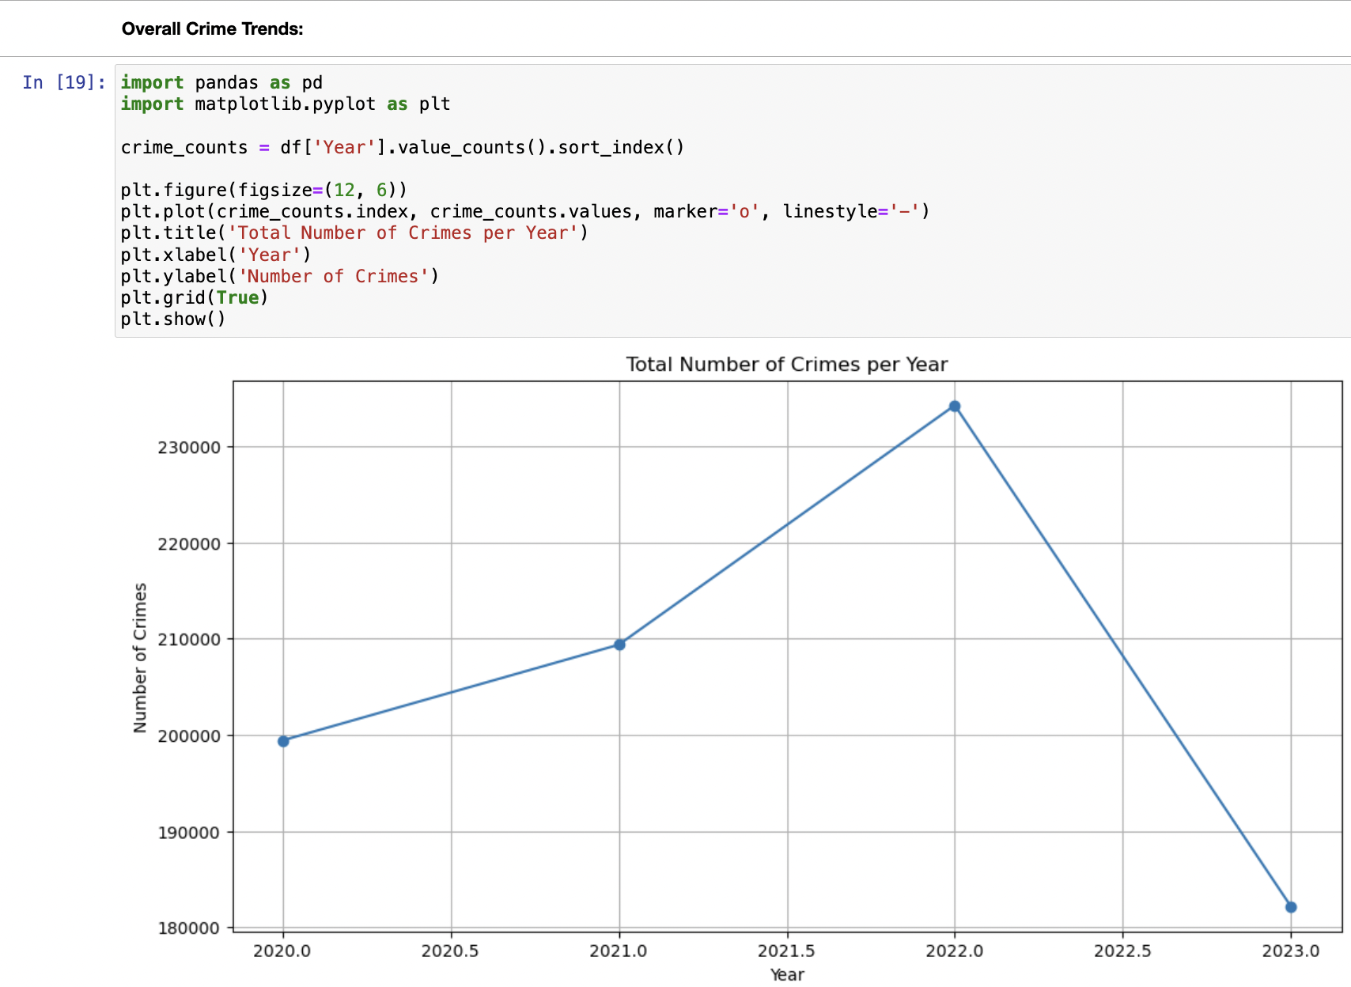
Visualization
2022 had the most crimes reported.

Slide 7
Conclusion
Dataset Overview: 825,212 records. Covers 2020-2023, providing recent data.
Crime Counts per Year: 2022 has the highest recorded crimes. 2021 follows with the second-highest count.
Trend Analysis: An upward trend in reported crimes from 2020 to 2022.
Data Diversity: Crime types vary, with "Crm Cd" ranging from 110 to 956.

Slide 8
Problem Statement 2:
Seasonal Patterns:
Group the data by month and analyse the average number of crimes per month over the years.

Slide 9
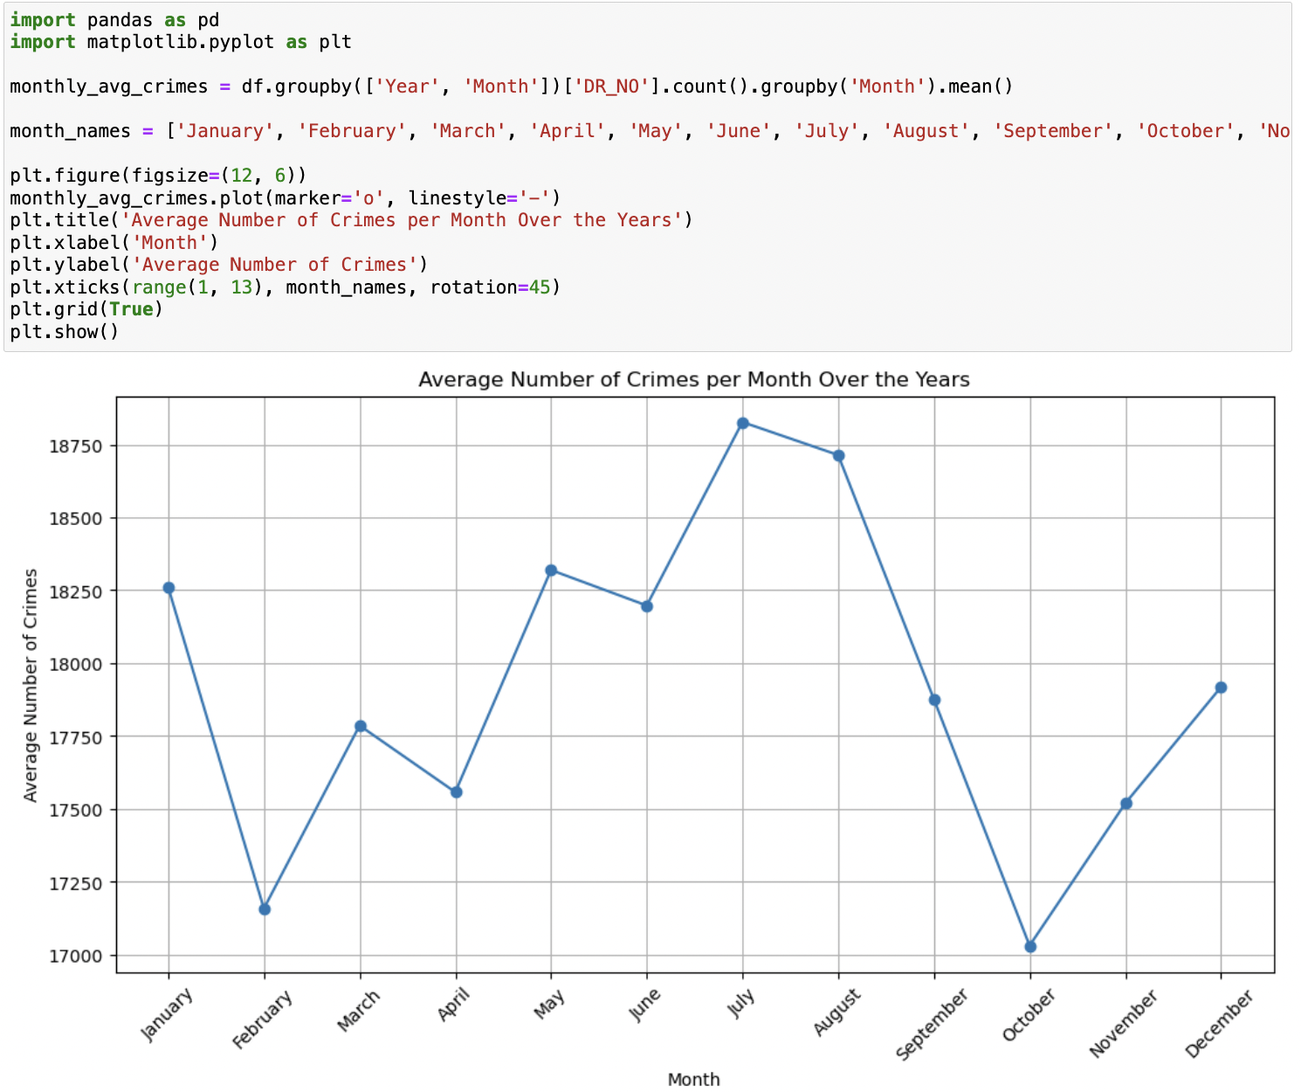
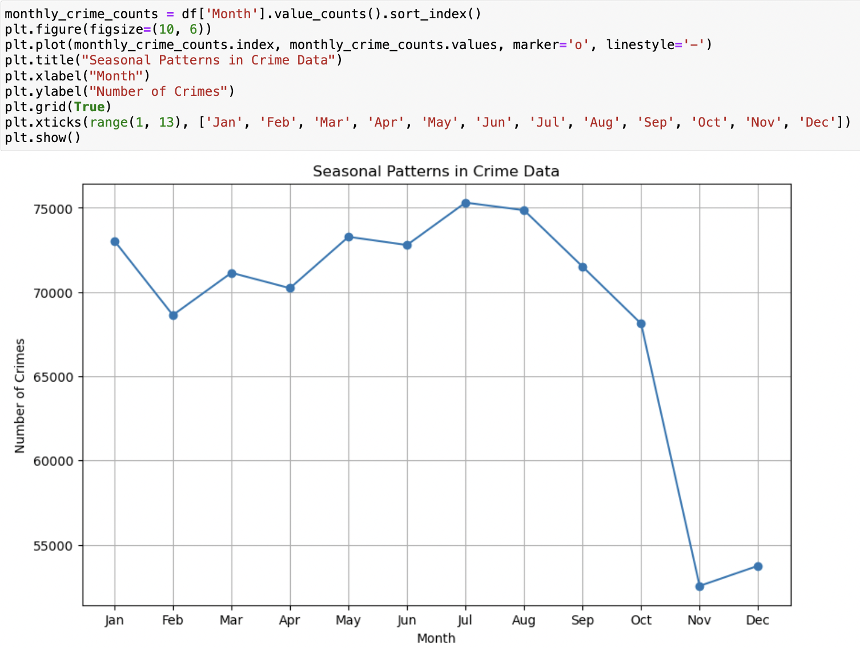
Visualization
We can see that more crimes are reported during the month of July.

Slide 10
Conclusion
Monthly Crime Count: The dataset covers the years 2020 to 2023, with crime incidents reported in various months. On average, there are approximately 1336 reported crimes per month.
Yearly Trends: The data shows that the number of reported crimes varies from year to year, with a slight increase over time. This suggests that there might be an overall upward trend in crime incidents during this period.
Monthly Variations: The monthly distribution of crimes is not uniform. Some months have higher average crime counts, while others have lower counts. This suggests that there may be seasonal or other factors influencing crime rates.

Slide 11
Problem statement 3
Count the occurrences of each crime type and identify the one with the highest frequency.

Slide 12
Data Acquisition
Downloaded Crime data from https://data.lacity.org/Public-Safety/Crime-Data-from-2020-to-Present/

Slide 13
Data Inspection and Cleaning part 1:
Relevant columns were selected, including 'Crm Cd Desc’.
Data types were converted i.e numerical values to appropriate numerical types.
Numerical columns were converted into appropriate numeric types
Missing values were handled.
Duplicate rows were removed.
Ten most common crimes were filtered out.

Slide 14
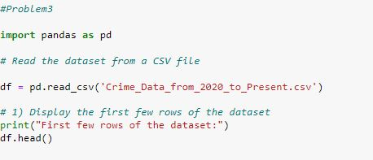
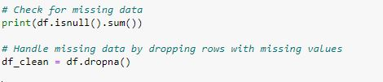
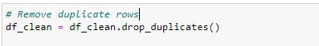
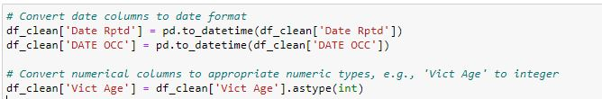
Data Cleaning and Inspection part 2:

Slide 15
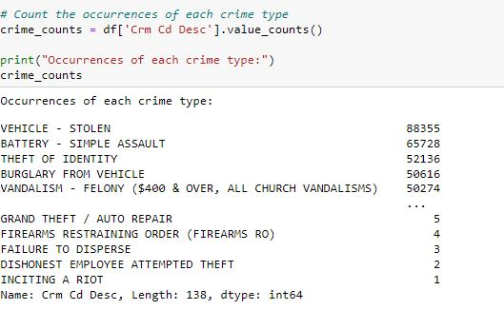
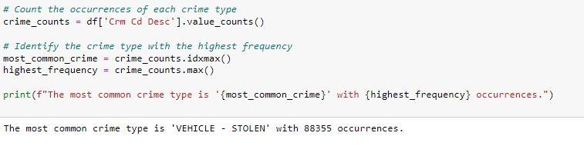
Data Analysis:

Slide 16
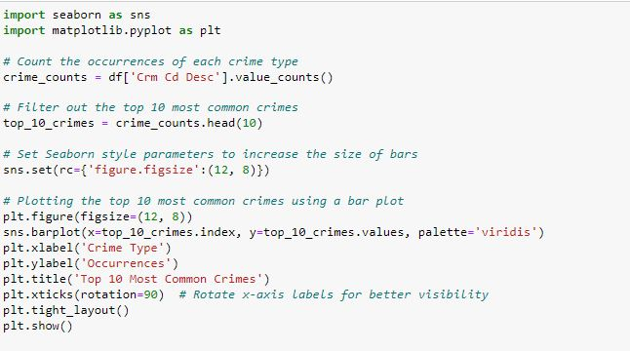
Data Visualization Code:

Slide 17
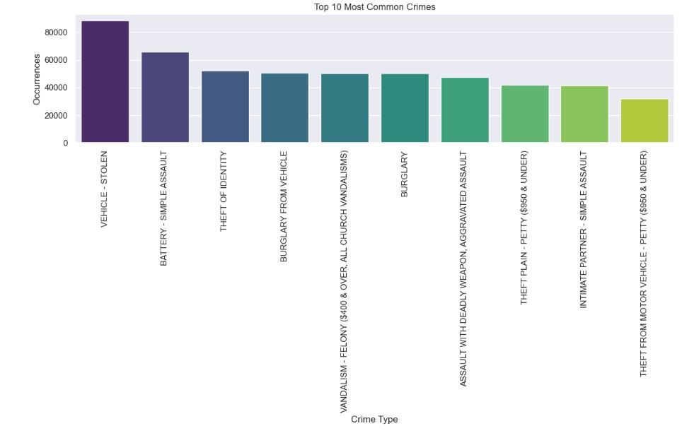
Data Visualization:

Slide 18
Conclusion:
Vehicle - Stolen" is the predominant crime, emphasizing a significant concern for vehicle theft in the represented area.
Crimes related to assault, both "Battery - Simple Assault" and "Intimate Partner - Simple Assault", are also notably high, indicating a prevailing issue with physical altercations.
While the top crimes are considerably frequent, there's a sharp decline as we progress to the less common crimes in the top 10 list, highlighting a concentration of specific criminal activities.

Slide 19
Problem statement 4:
Group the data by region or city and compare crime rates between descriptive statistics or visualizations

Slide 20
Data Cleaning and Inspection part 1:
Relevant columns were selected, including 'Crm Cd Desc’.
Data types were converted i.e numerical values to appropriate numerical types.
Numerical columns were converted into appropriate numeric types
Missing values were handled.
Duplicate rows were removed.
Ten most common crimes were filtered out.

Slide 21
Data Cleaning and Inspection part 2:

Slide 22
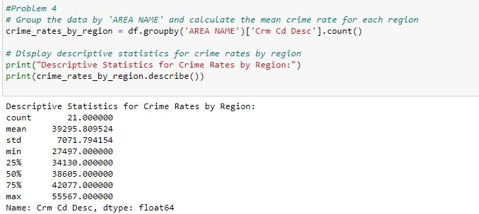
Data Analysis part 1

Slide 23
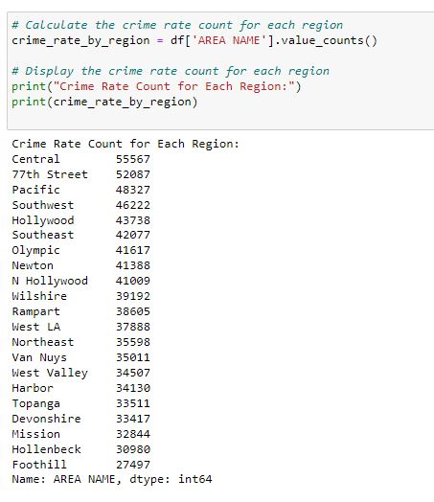
Data Analysis Part 2:

Slide 24
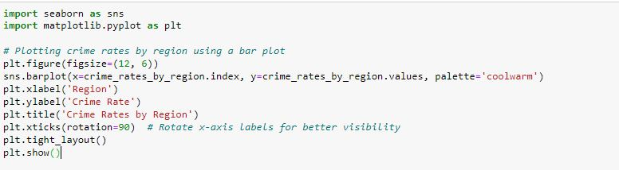
Data Visualization code:

Slide 25
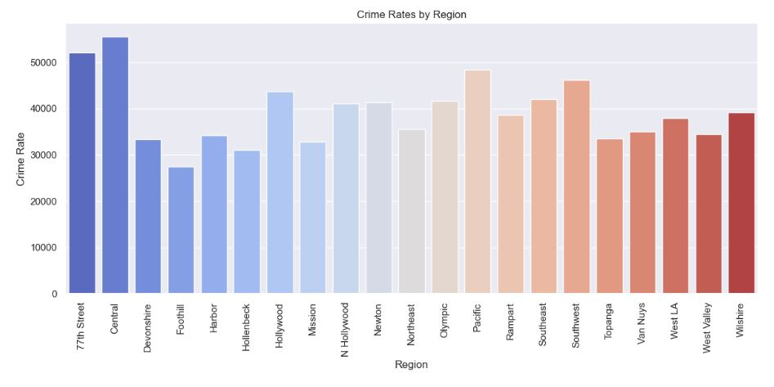
Data Visualization:

Slide 26
Conclusion:
Regions "77th Street" and "Central" emerge as significant hotspots, showcasing notably elevated crime rates compared to other areas.
In contrast, the "West LA", "West Valley", and "Wilshire" regions manifest as safer precincts, with their crime rates substantially lower, underscoring the necessity for region-specific crime prevention strategies.

Slide 27
Problem Statement 5:
Correlation with Economic Factors:
Collect economic data for the same time frame and use statistical methods like correlation analysis to assess the relationship between economic factors and crime rates.

Slide 28
Data Acquisition
Downloaded Crime data from https://data.lacity.org/Public-Safety/Crime-Data-from-2020-to-Present/
Downloaded Monthly Consumer Price Index data from https://www.bls.gov/news.release/cpi.toc.htm (CPI is a measure that examines the average change over time in the prices paid by urban consumers for a market basket of consumer goods and services).
Downloaded Monthly Labor Force Statistics data from https://www.bls.gov/news.release/empsit.toc.htm

Slide 29
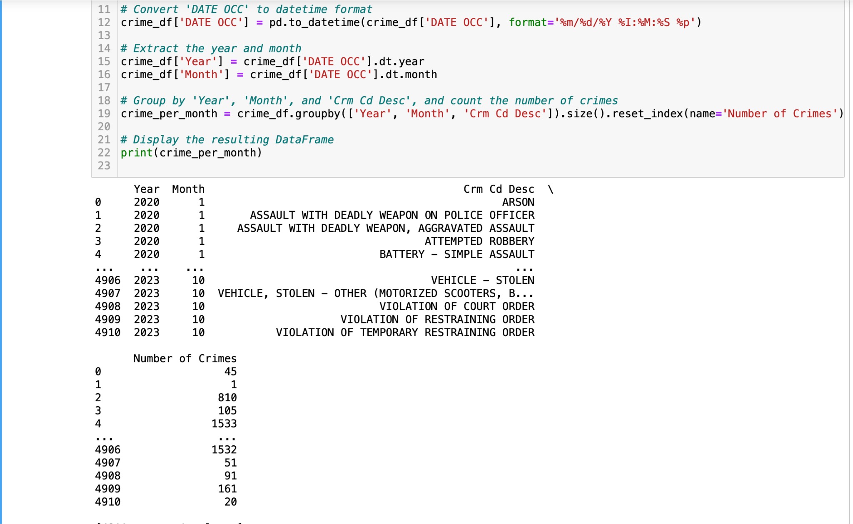
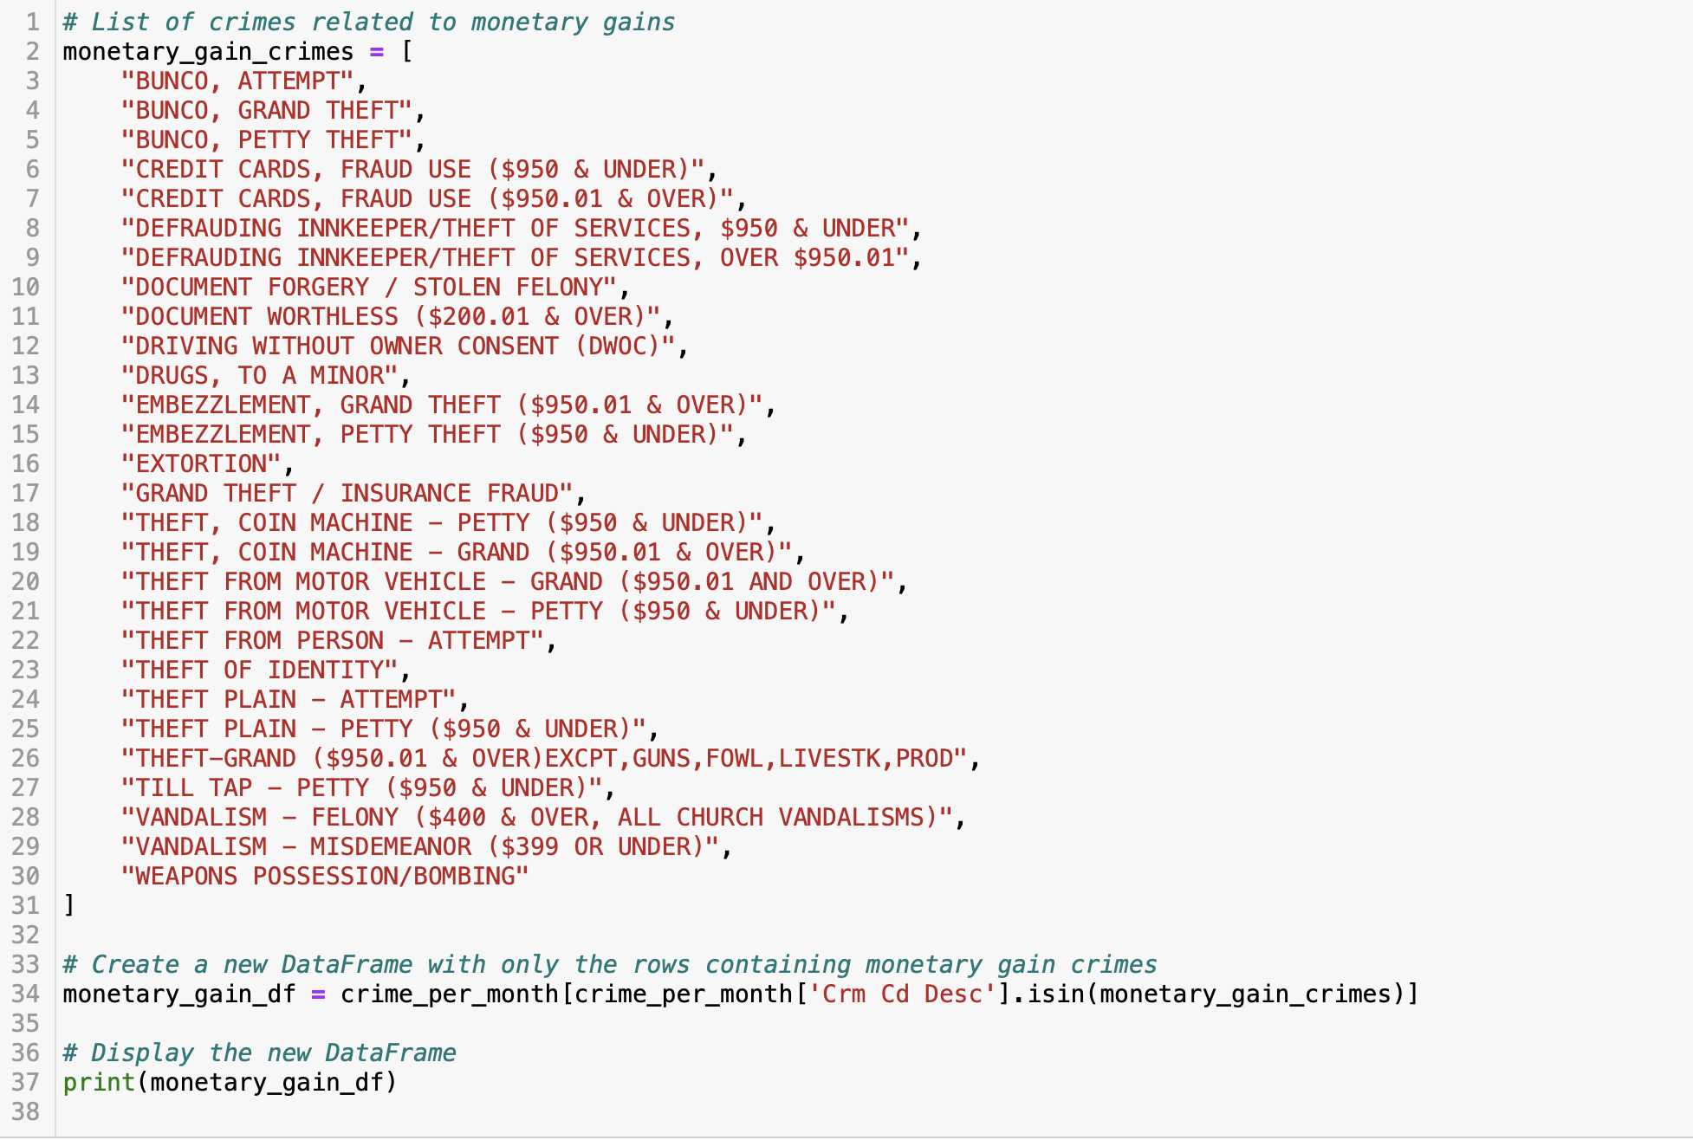
Data Inspection and cleaning part-1
Load CSV data provided.
Group data by 'Year', 'Month', and 'Crm Cd Desc' (Type of crime)
Identify distinct crimes
Filter crimes related to monetary gains

Slide 30
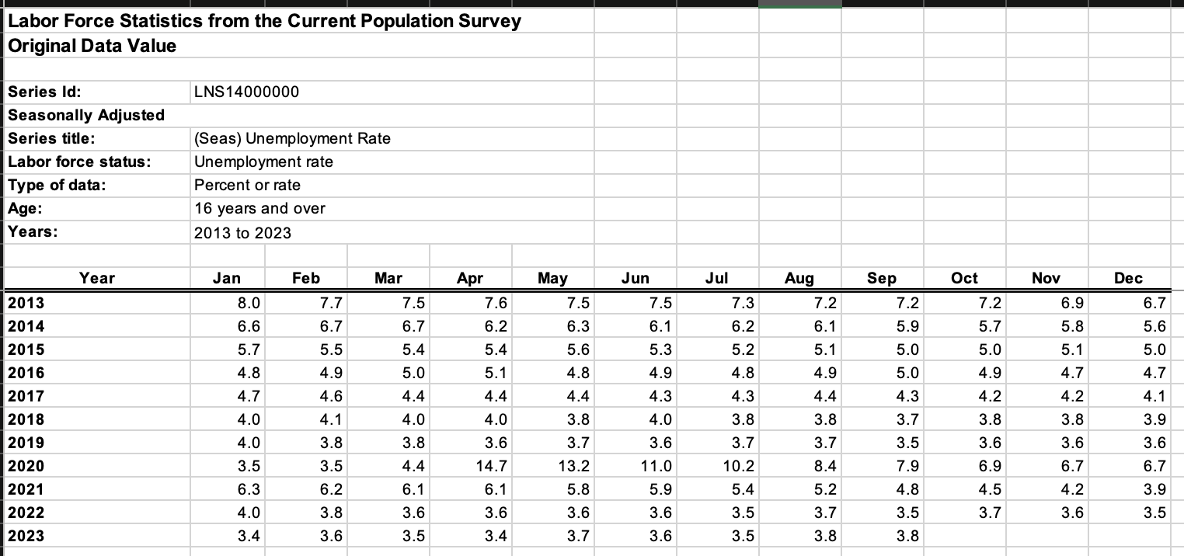
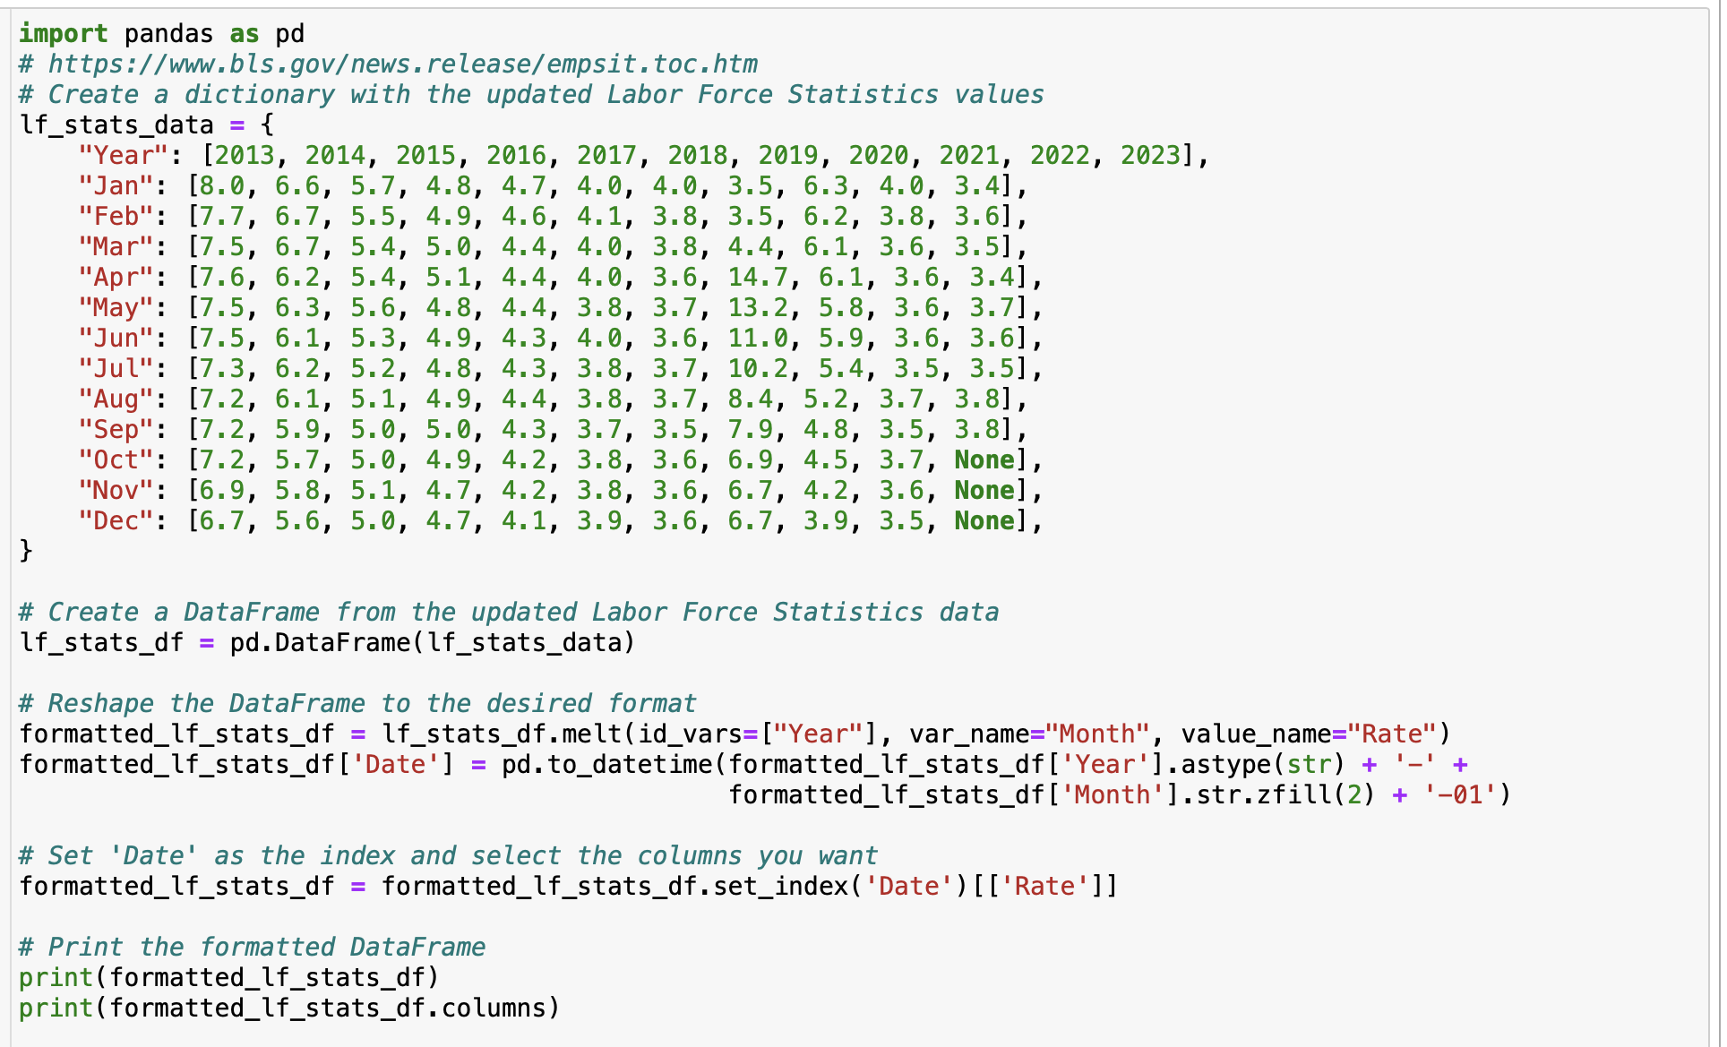
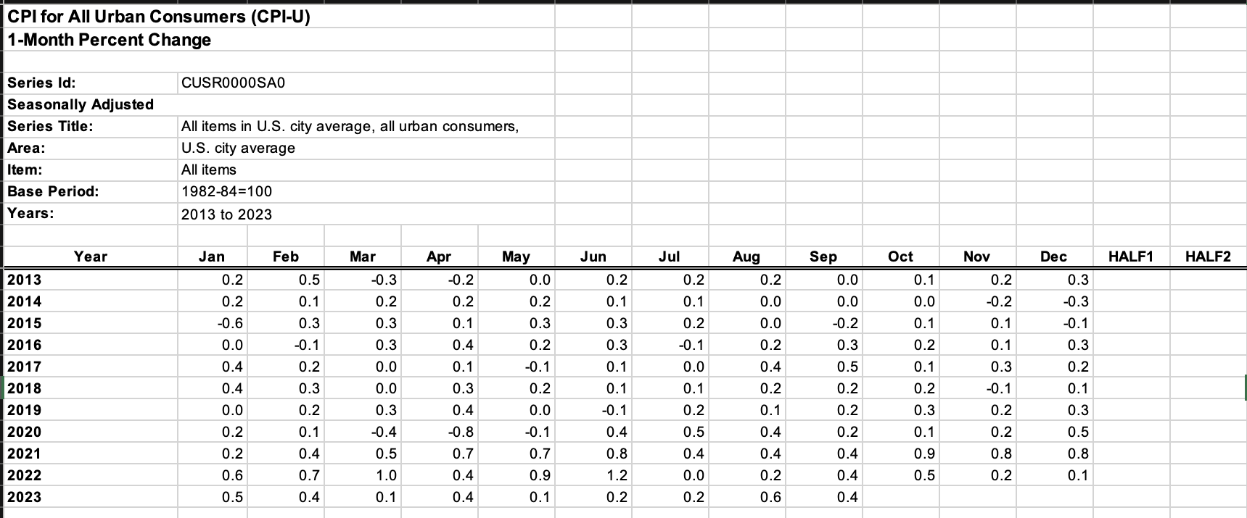
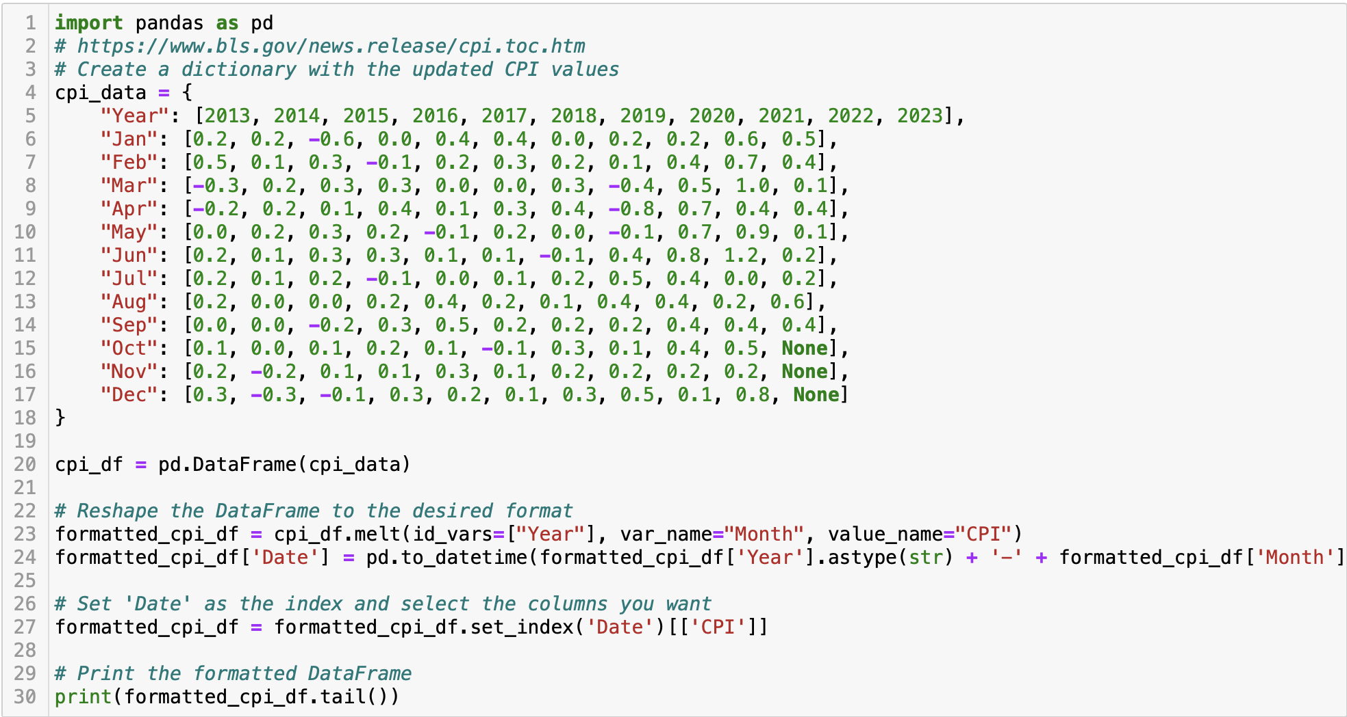
Data Inspection and cleaning part-2
# Filter data for the years 2020 to 2023
formatted_lf_stats_df = formatted_lf_stats_df[(formatted_lf_stats_df['Year'] >= 2020) & (formatted_lf_stats_df['Year'] <= 2023)]
formatted_cpi_df = formatted_cpi_df[(formatted_cpi_df['Year'] >= 2020) & (formatted_cpi_df['Year'] <= 2023)]
print(formatted_lf_stats_df.head())
print(formatted_cpi_df.head())
Convert the obtained data into a dictionary.
Convert the dictionary to a data frame.
Convert the data into date format.
Reduce dataframe to include data from 2020 to 2023

Slide 31
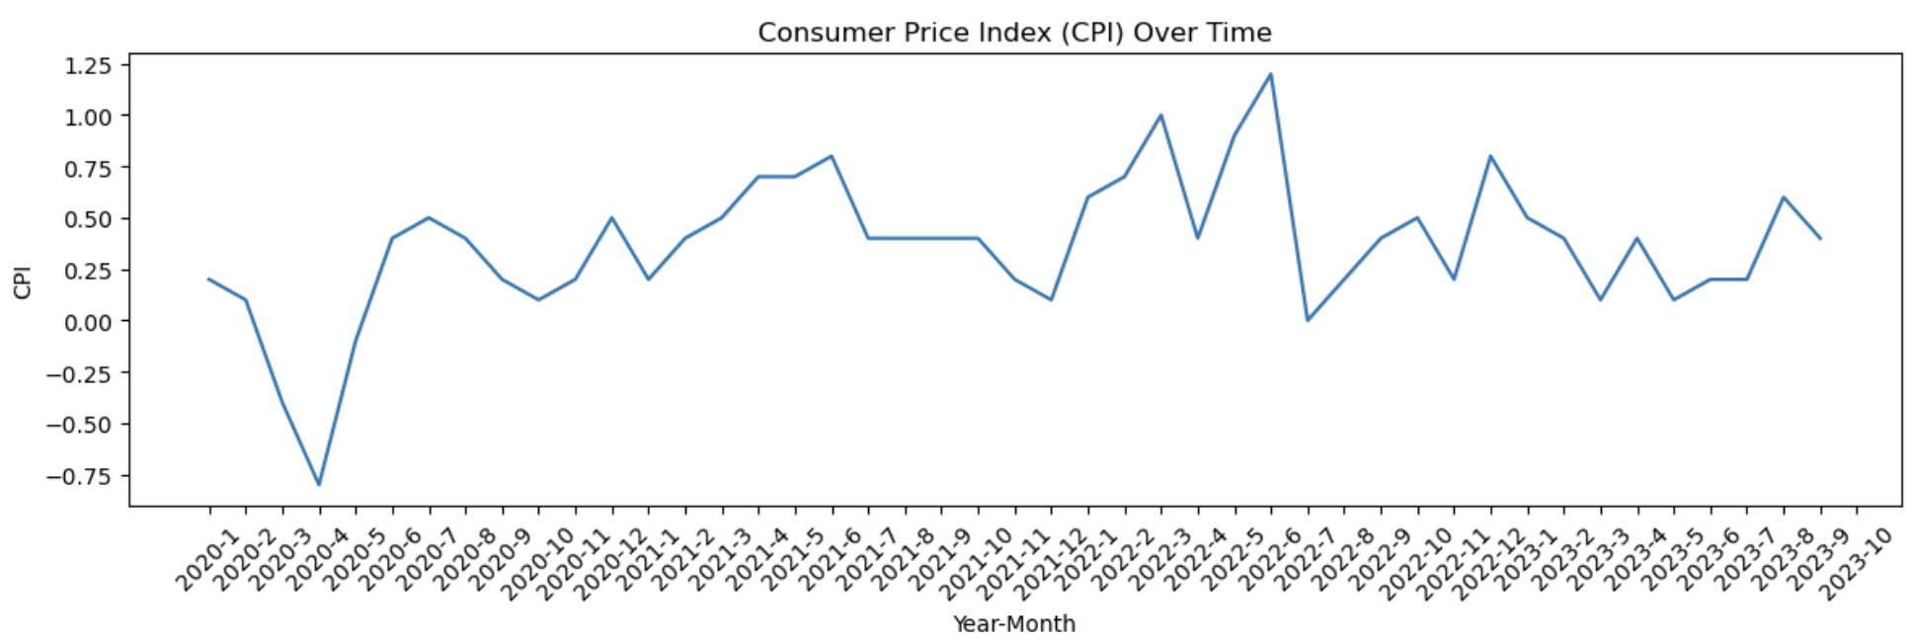
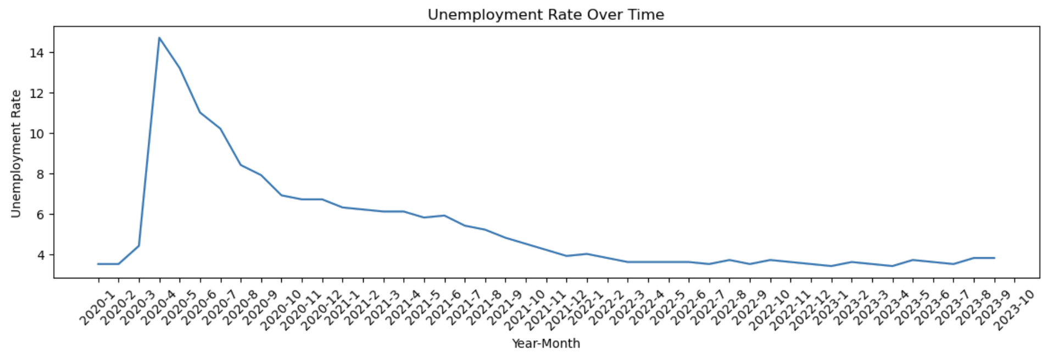
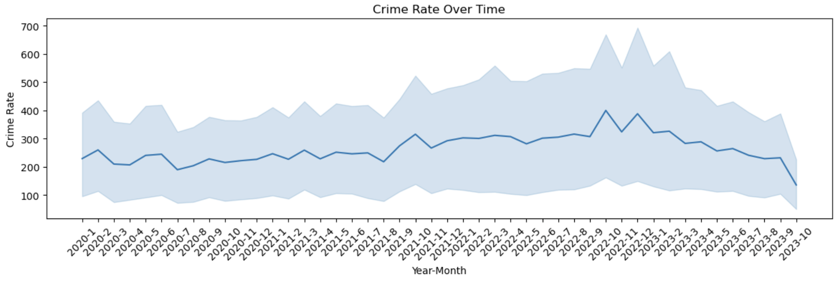
Visualization part-1
Initial visualisations include visualizing the cleaned data

Slide 32
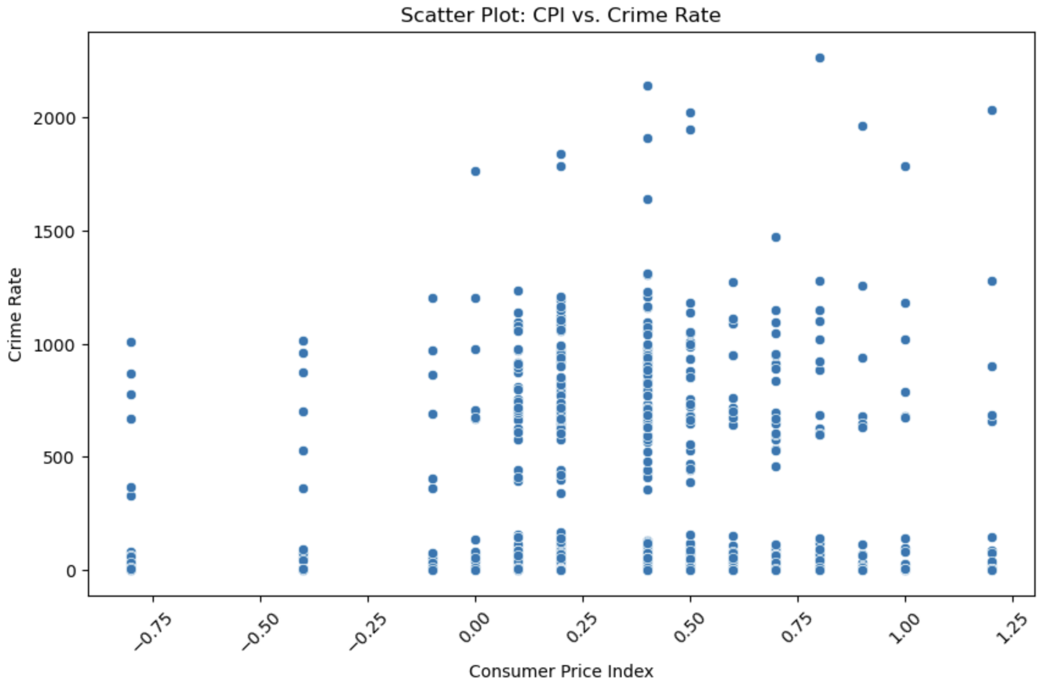
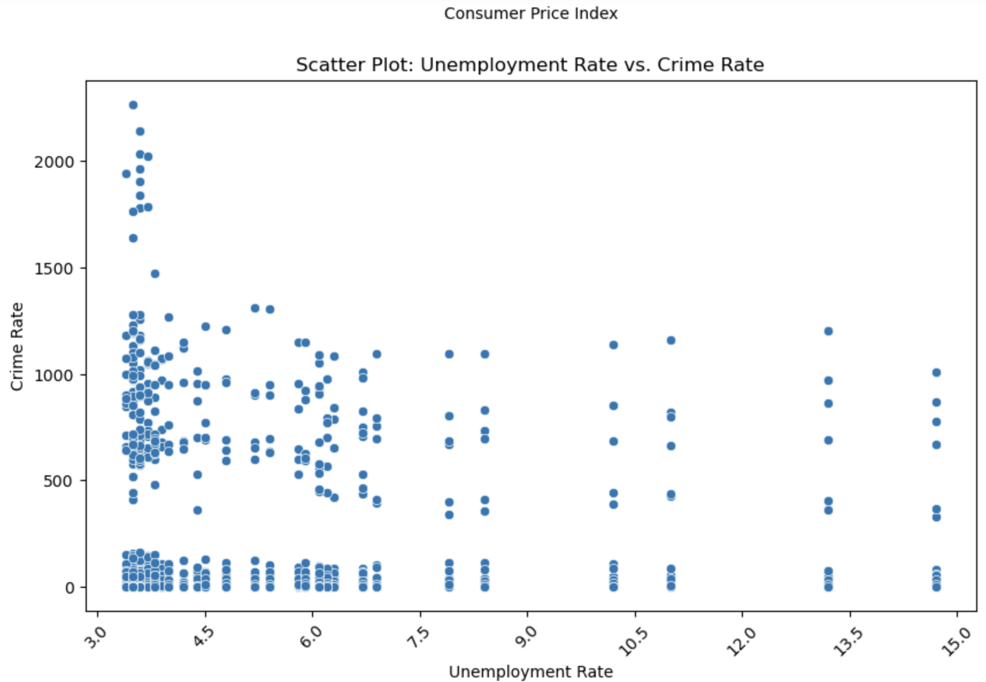
Visualization part-2
Visualizing Consumer Price index vs Crime Rate
Visualizing Unemployment Rate vs Crime Rate

Slide 33
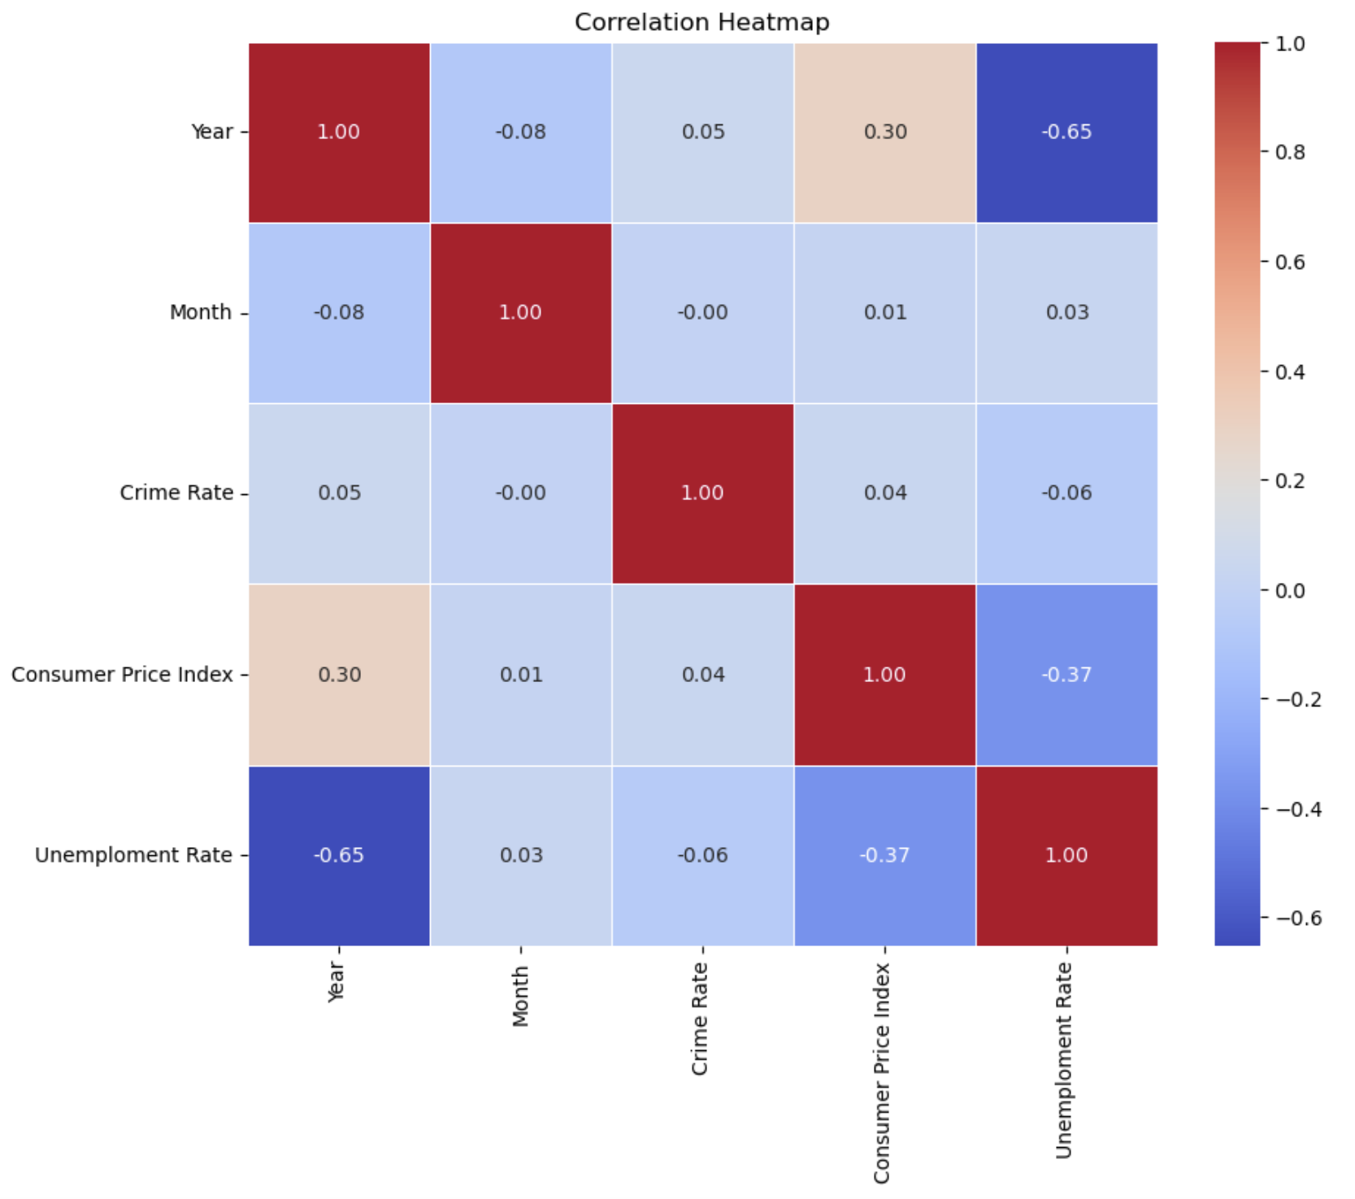
Visualization part-3: Correlation heat map

Slide 34
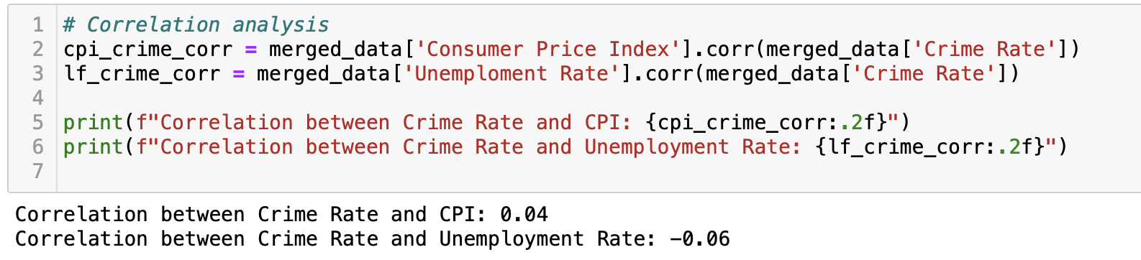
Correlation analysis
Correlation between Crime Rate and CPI: 0.04
Correlation between Crime Rate and Unemployment Rate: -0.06

Slide 35
Conclusion
Upon Visual inspection:
Consumer Price index vs Crime Rate: Crime rate increases with increase in CPI
Visualizing Unemployment Rate vs Crime Rate: Crime rate increases with decrease in Unemployment rate.
Correlation between Crime Rate and Consumer Price Index (CPI): 0.04
A correlation of 0.04 indicates a very weak positive correlation between crime rate and CPI. This means that there is a slight tendency for crime rate to increase as CPI increases, but the relationship is not strong.
Correlation between Crime Rate and Unemployment Rate: -0.06
A correlation of -0.06 indicates a very weak negative correlation between crime rate and unemployment rate. This means that there is a slight tendency for crime rate to decrease as the unemployment rate increases, but again, the relationship is not strong.

Slide 36
Problem Statement 6:
Day of the Week Analysis:
Group the data by day of the week and analyze crime frequencies for each day.

Slide 37
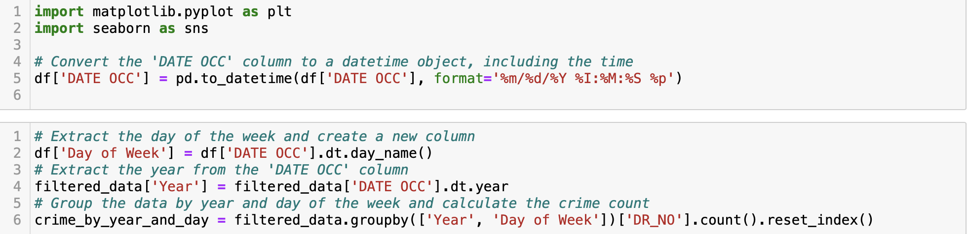
Data Acquisition Inspection and cleaning
Downloaded Crime data from https://data.lacity.org/Public-Safety/Crime-Data-from-2020-to-Present/
Convert the 'DATE OCC' column to a datetime object
Extract day of the week and add it to the dataframe
Extract year from DATE OCC (Date of crime)
Group data by day of the week and year

Slide 38
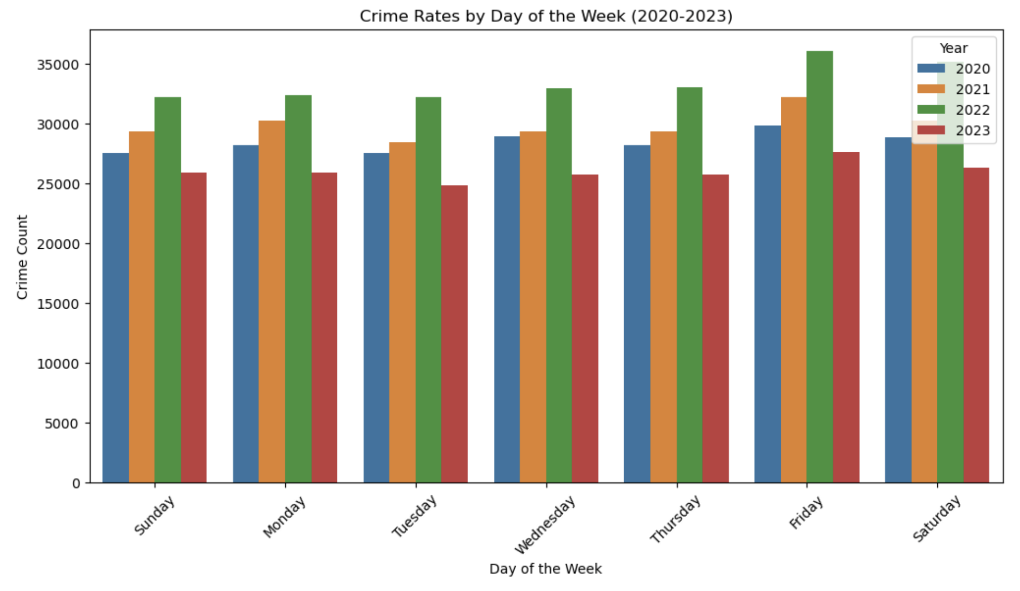
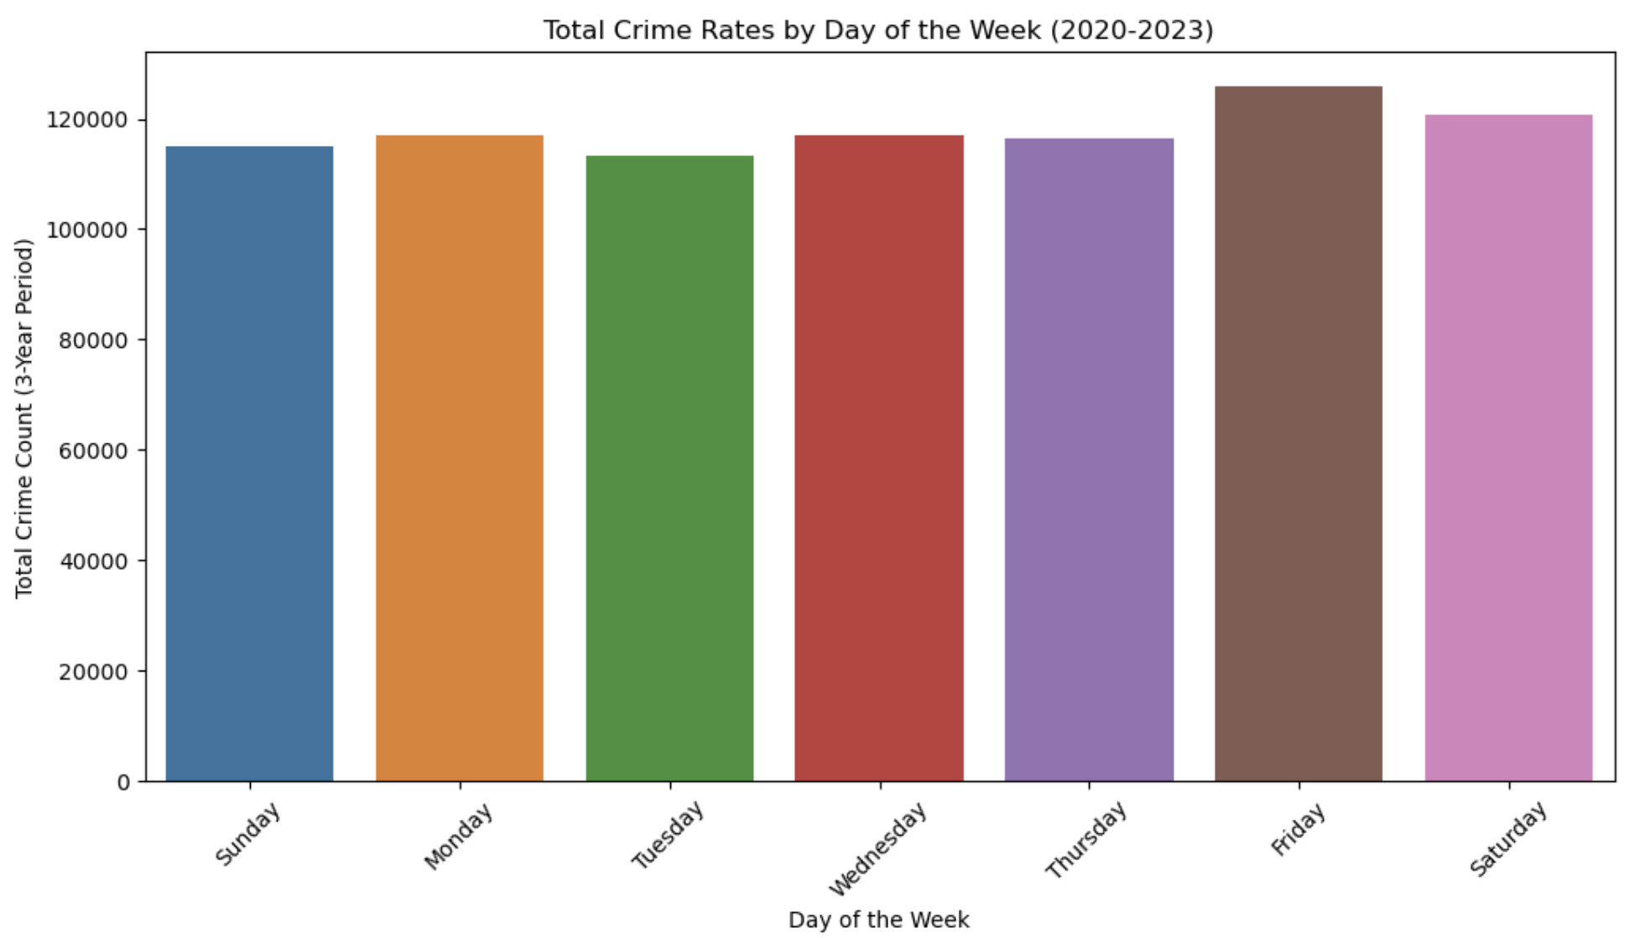
Visualization
Yearly crime rates by Day of week
Total crime rates by Day of week

Slide 39
Conclusion
Overall Crime Trends: The data showed that there is a variation in the number of reported crimes across different days of the week. The highest total crime rate was observed on Fridays, followed by Saturdays. Sundays had the lowest crime rate among the weekdays.
Weekday vs. Weekend: The data indicated a clear difference between weekday and weekend crime rates. Weekdays (Monday to Thursday) generally had lower crime rates compared to weekends (Friday to Sunday).
Yearly Comparison: The analysis also revealed that the total crime rates varied from year to year. While 2022 had the highest total crime rate among the three years, 2021 had the second-highest, followed by 2020 and 2023. The highest crime rates were consistently observed on Fridays for each year.

Slide 40
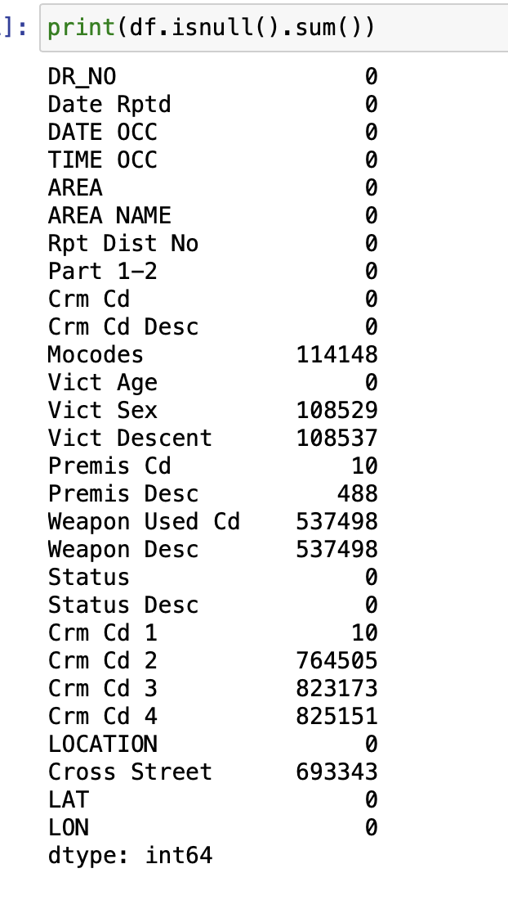
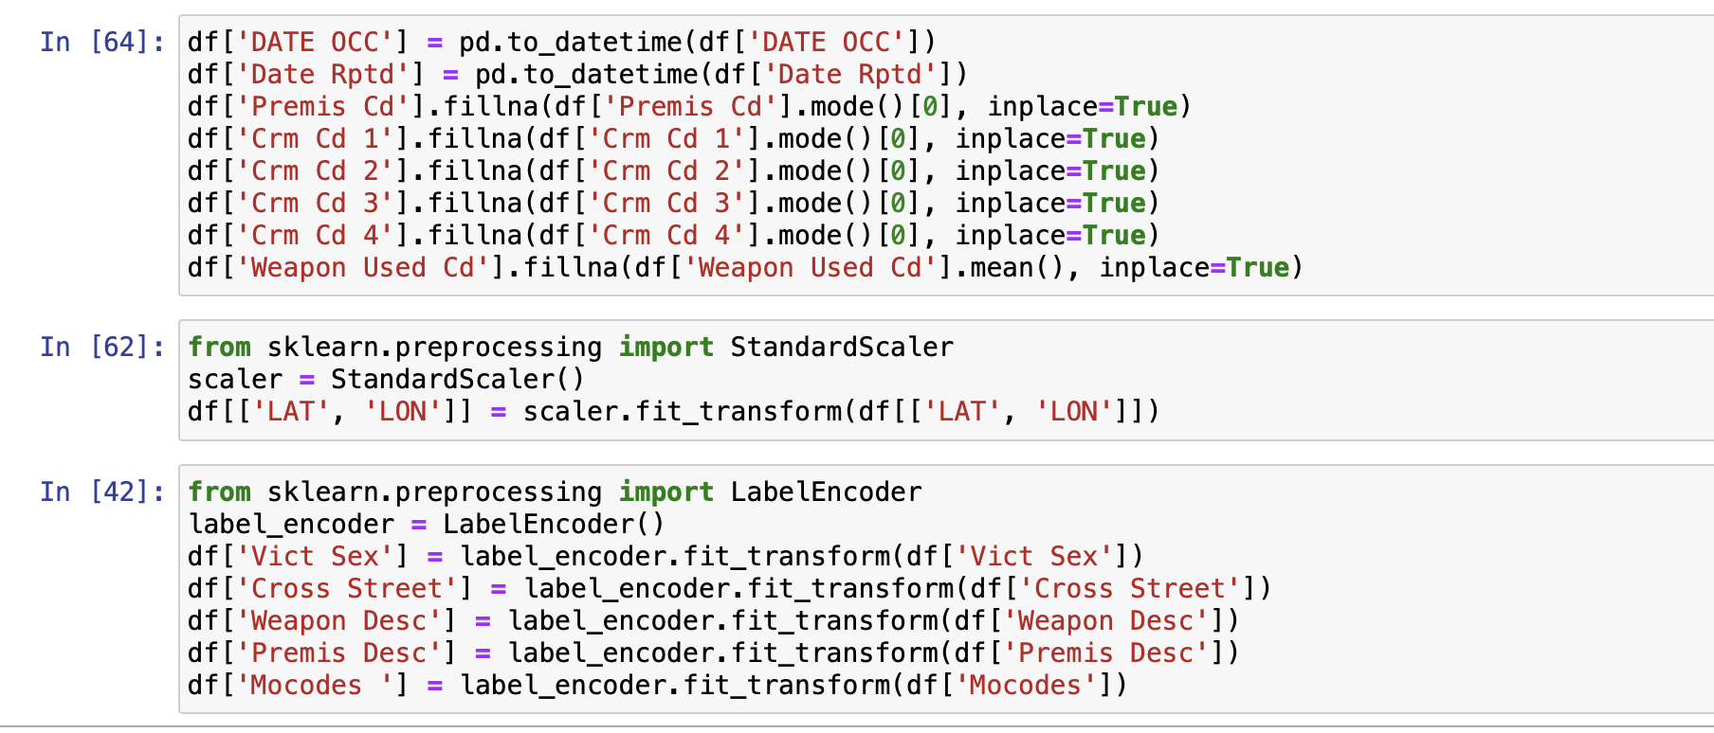
Problem statement 7:
Identify major events or policy changes during the dataset period and analyze crime rate changes before and after these events
import√
1. DATA ACQUISITION : Downloaded Crime data from https://data.lacity.org/Public-Safety/Crime-Data-from-2020-to-Present/
2. DATA INSPECTION :
Load CSV data provided.
Find and handle the missing and null values in the dataset.
Standardize or normalize numerical data and encoding categorical data if required.

Slide 41
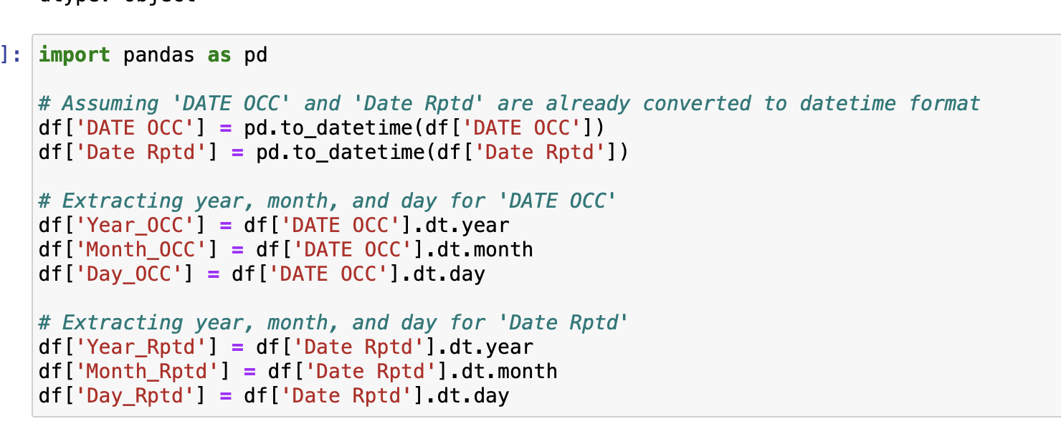
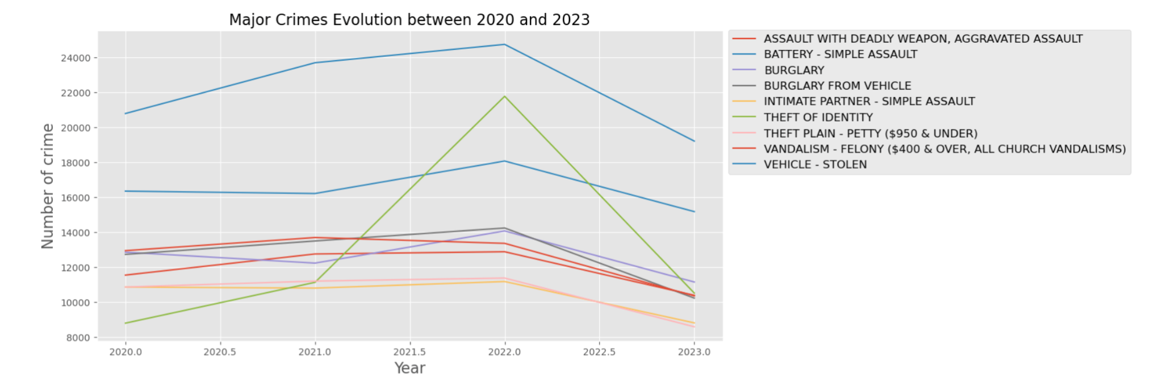
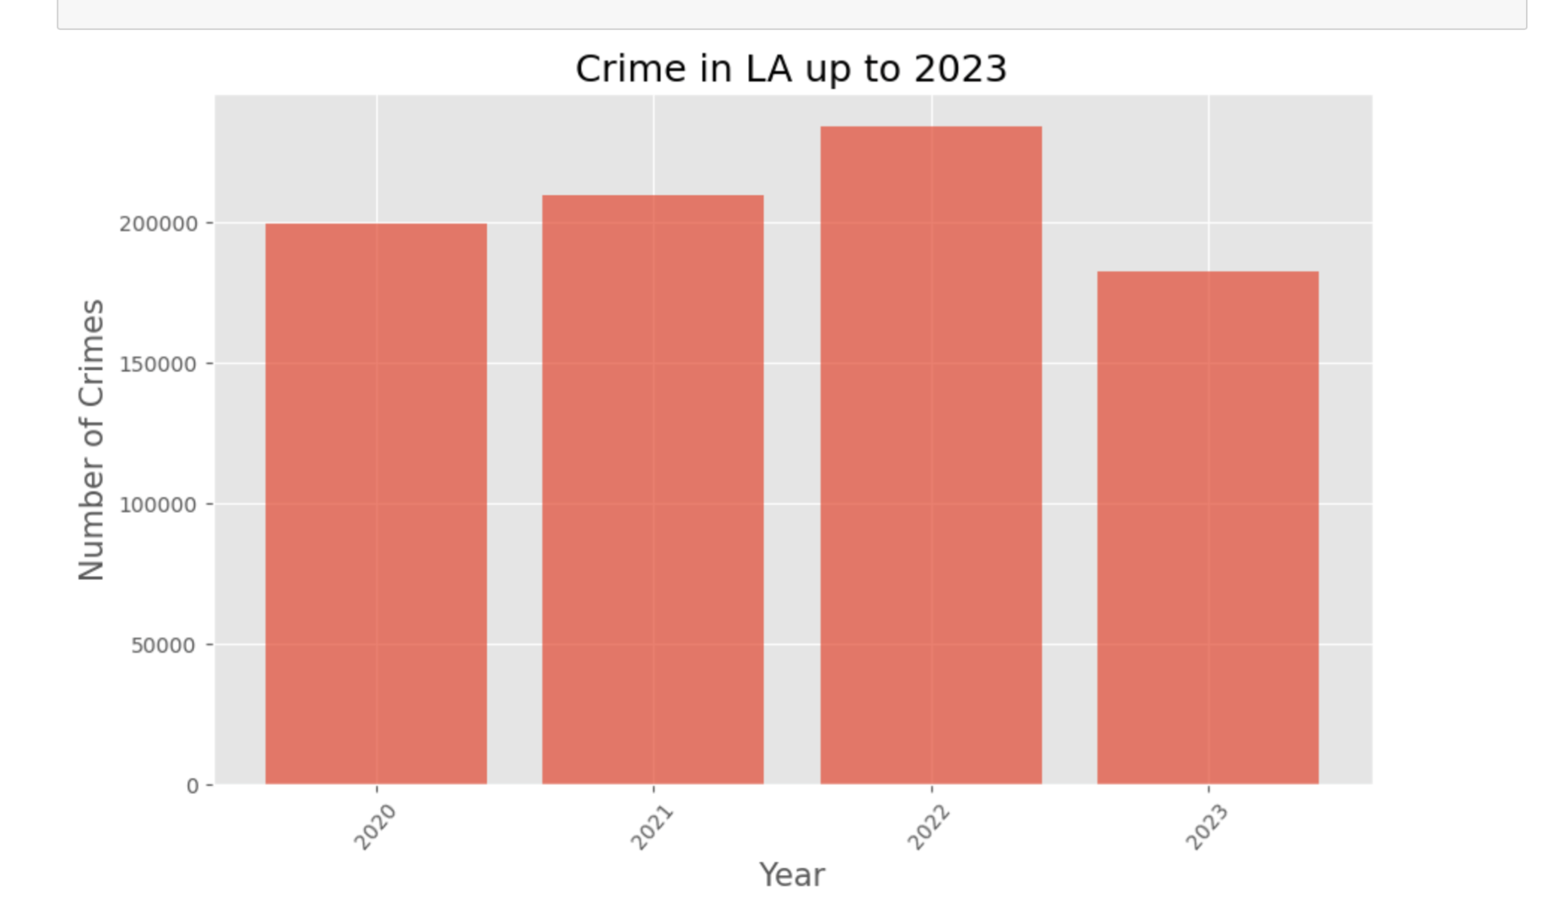
Converting the date columns into date time datatype and other columns into their respective data types as per requirement.
3. VISUALISATION
EVOLUTION OF CRIME OVER THE YEARS

Slide 42
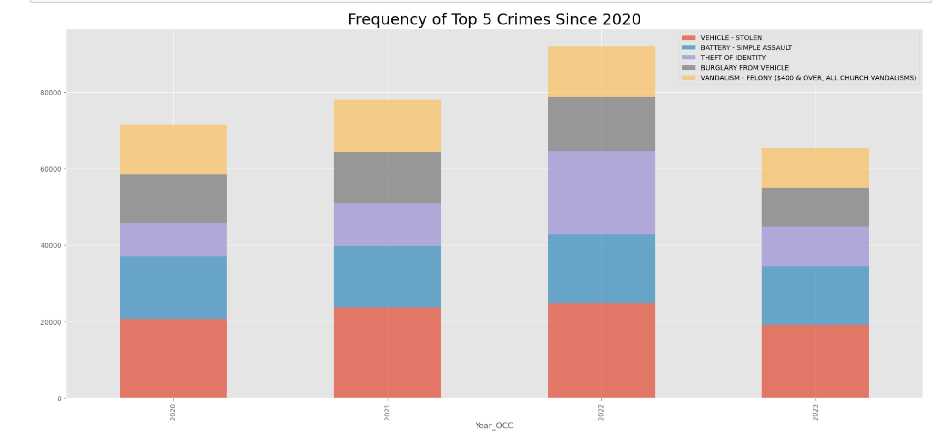
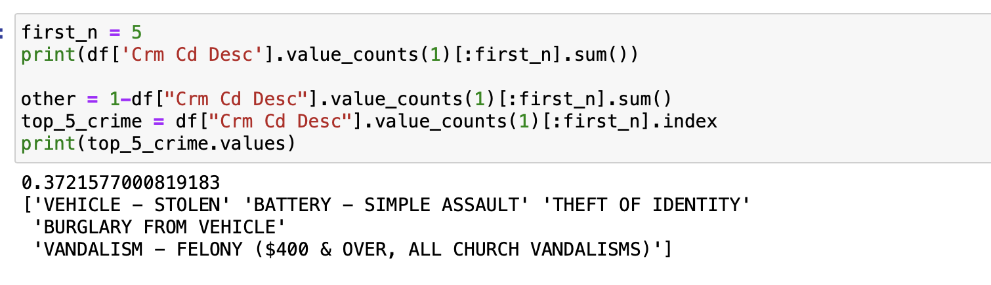
EVOLUTION OF TOP 5 CRIMES OVER THE YEARS
4. CONCLUSION
Despite various new reforms and policies being introduced, the crime rates over the years have been increasing, it was highest in 2022 but decreased in 2023.
The highest frequency of crime amongst all is vehicle being stolen, it was peak during 2022 with more than 24,000 vehicles being stolen.
Also, there was a sharp increase in theft of identity during 2022 by an increase of 9000 cases.
Simple assault and petty theft has minimized by the beginning of 2023.

Slide 43
Problem statement 8:
Use statistical methods or data visualization techniques to identify dataset outliers and investigate unusual patterns.
DATA ACQUISITION : Downloaded Crime data from https://data.lacity.org/Public-Safety/Crime-Data-from-2020-t
2. DATA INSPECTION :
Load CSV data provided.
Find and handle the missing and null values in the dataset.
Standardize or normalize numerical data and encoding categorical data if required.

Slide 44
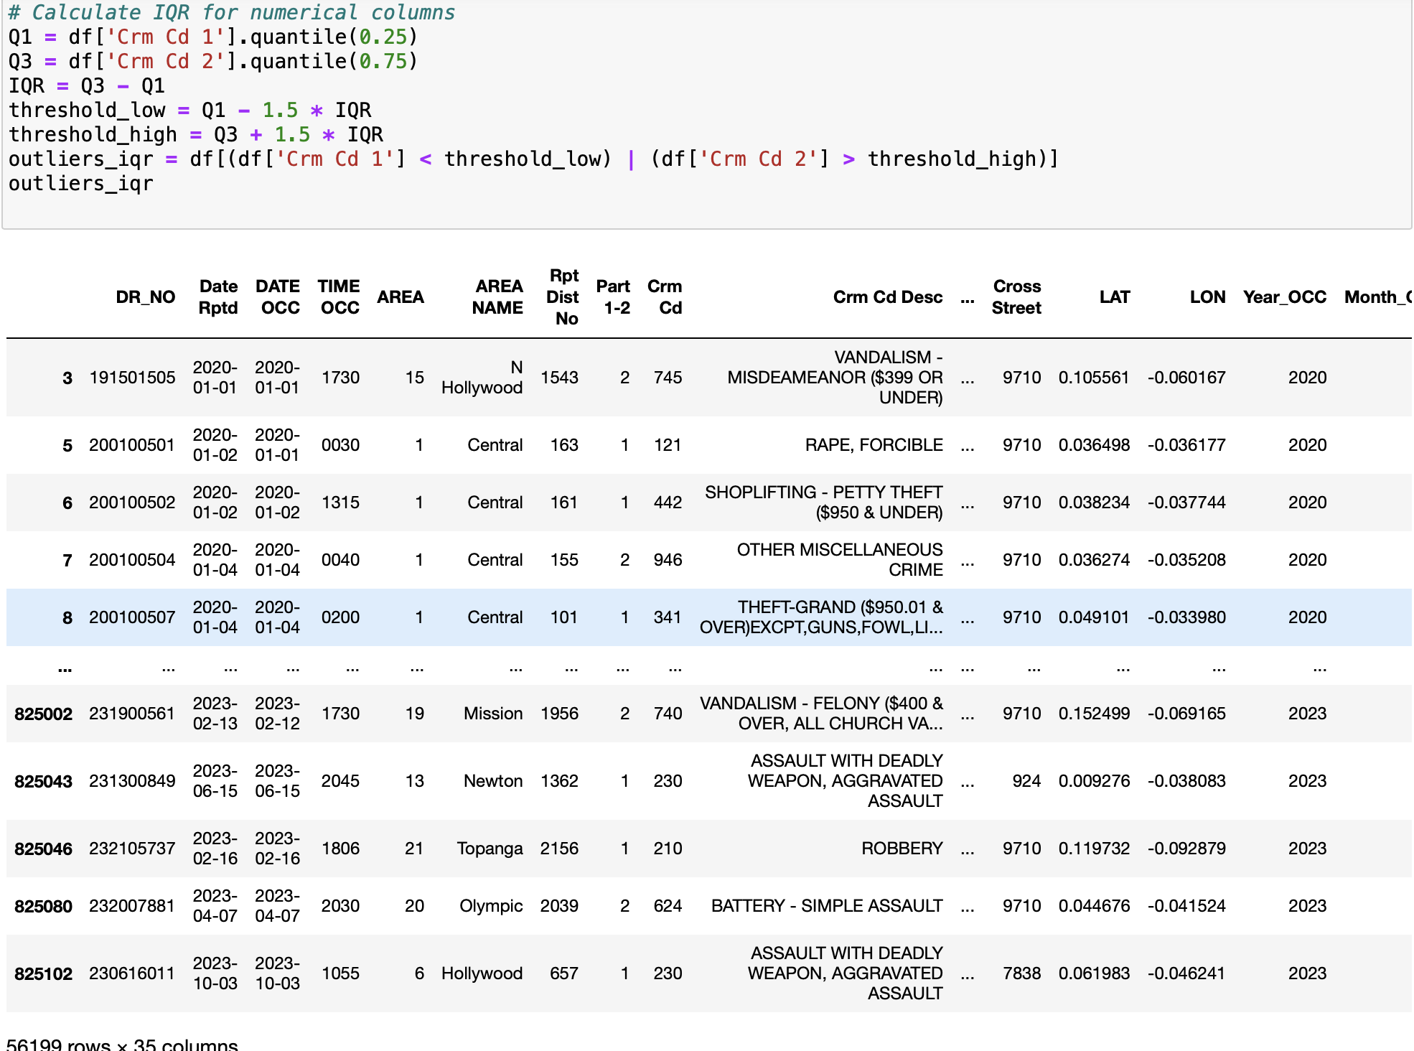
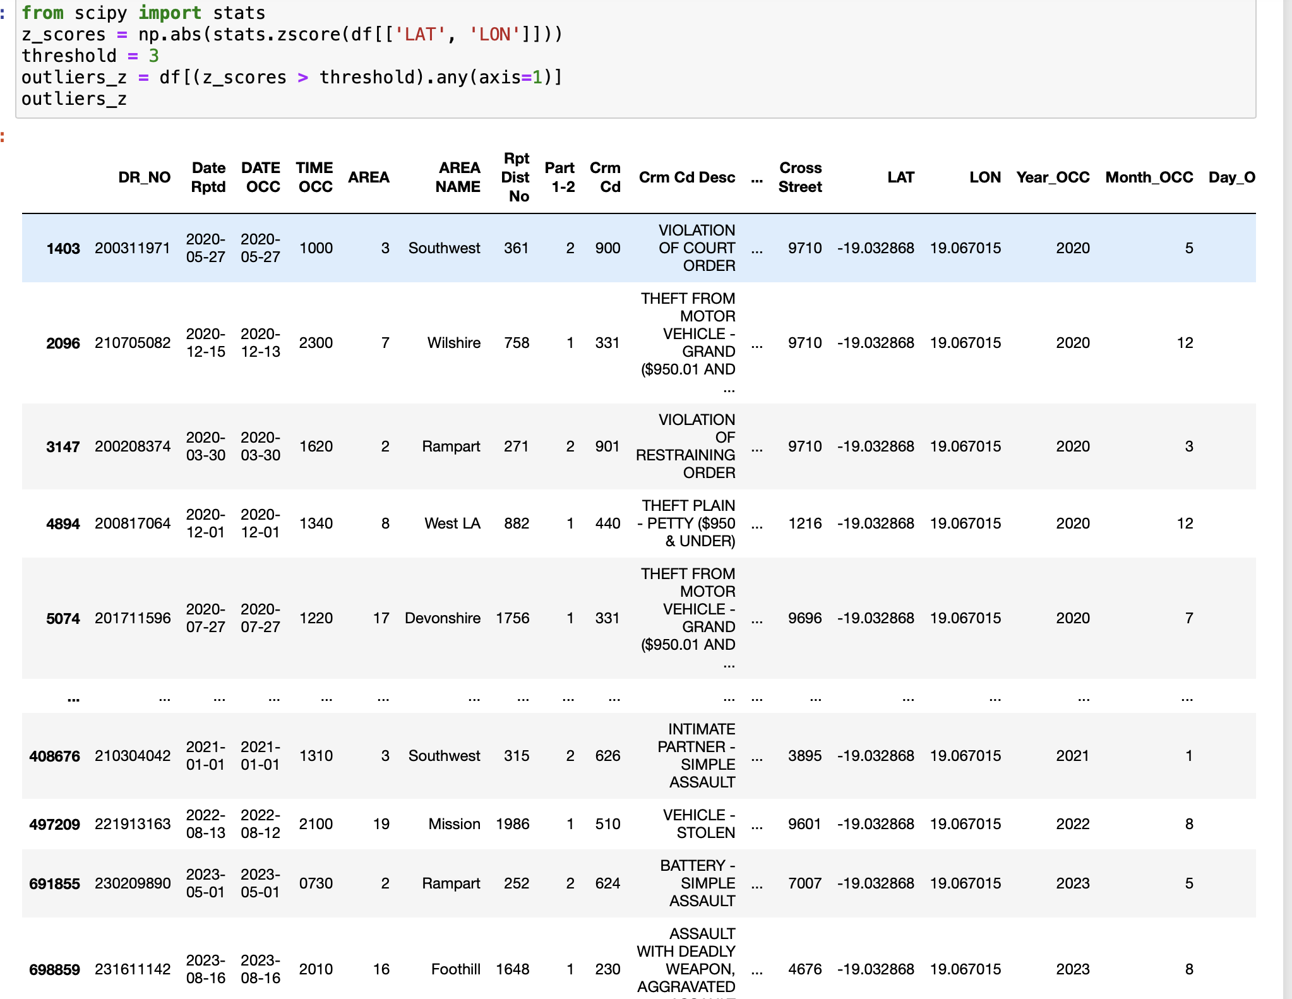
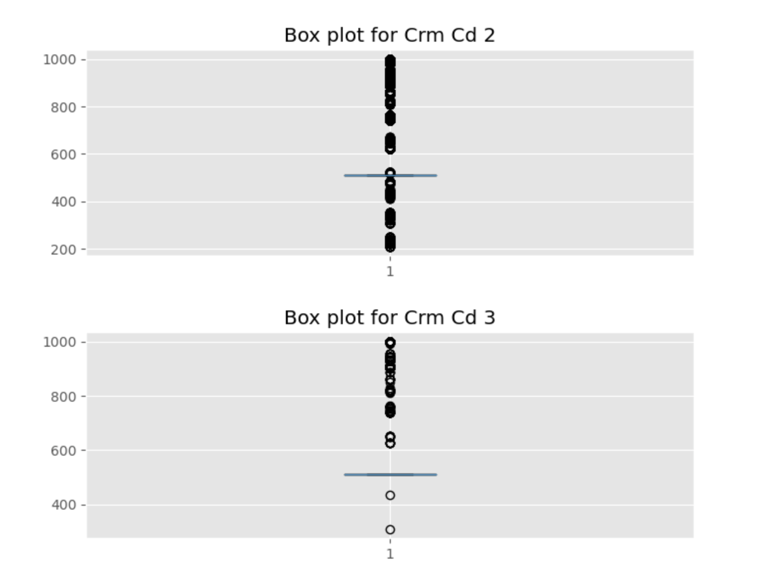
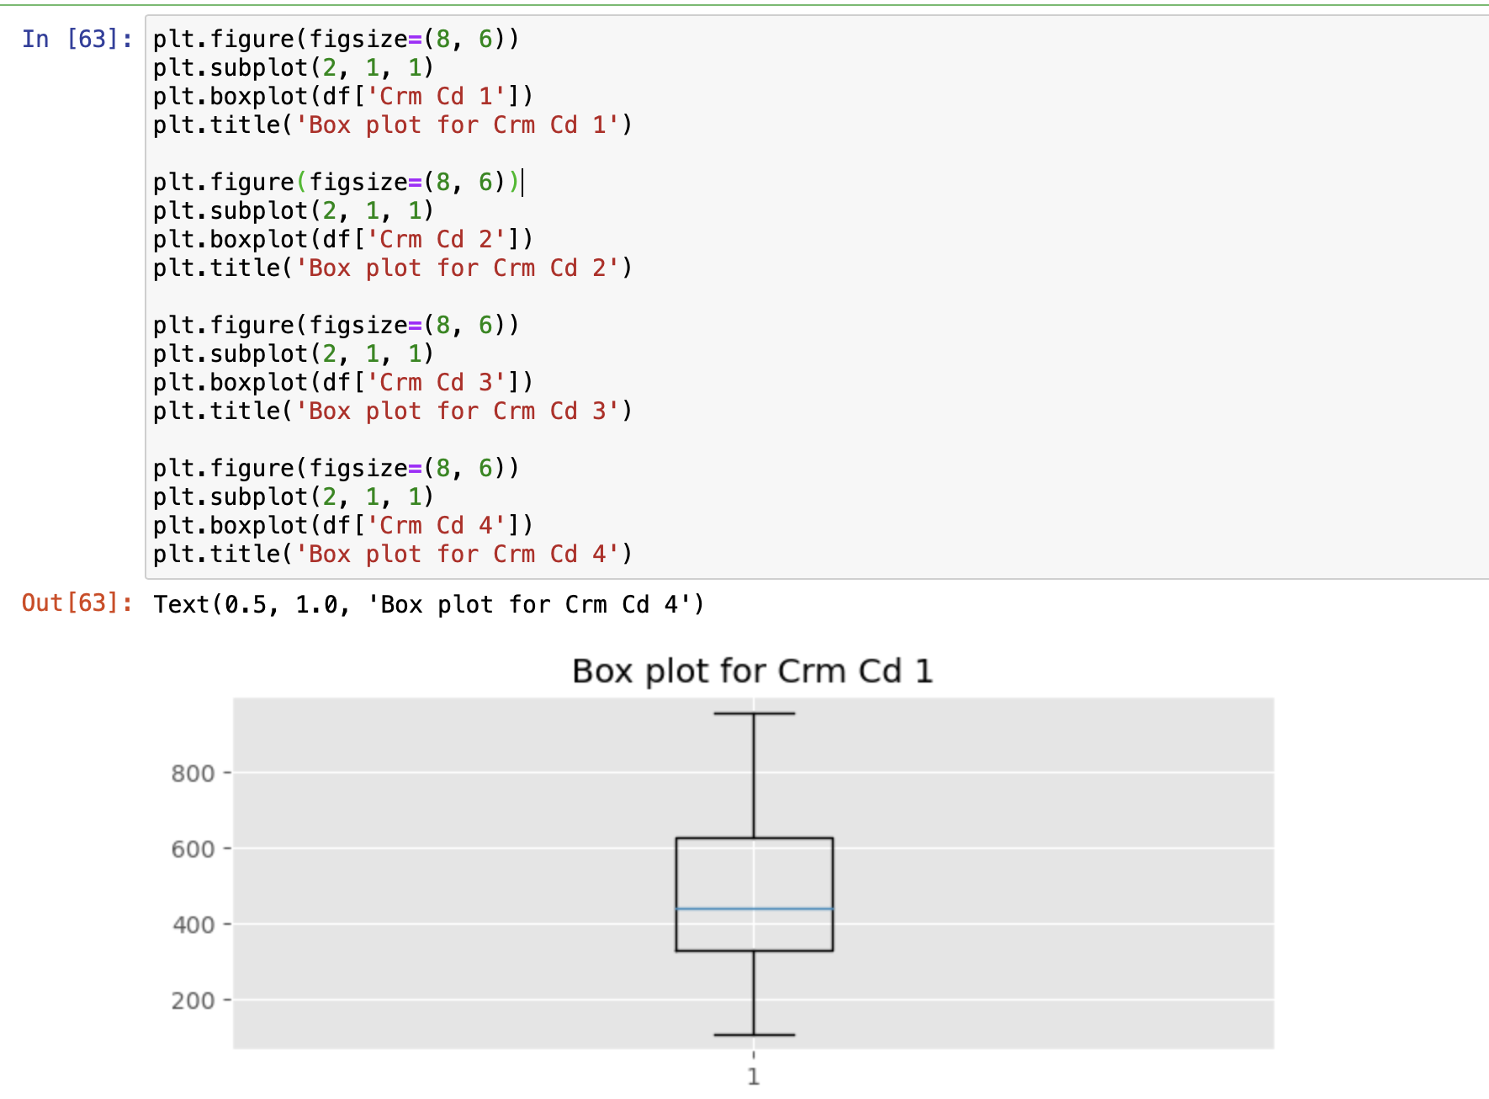
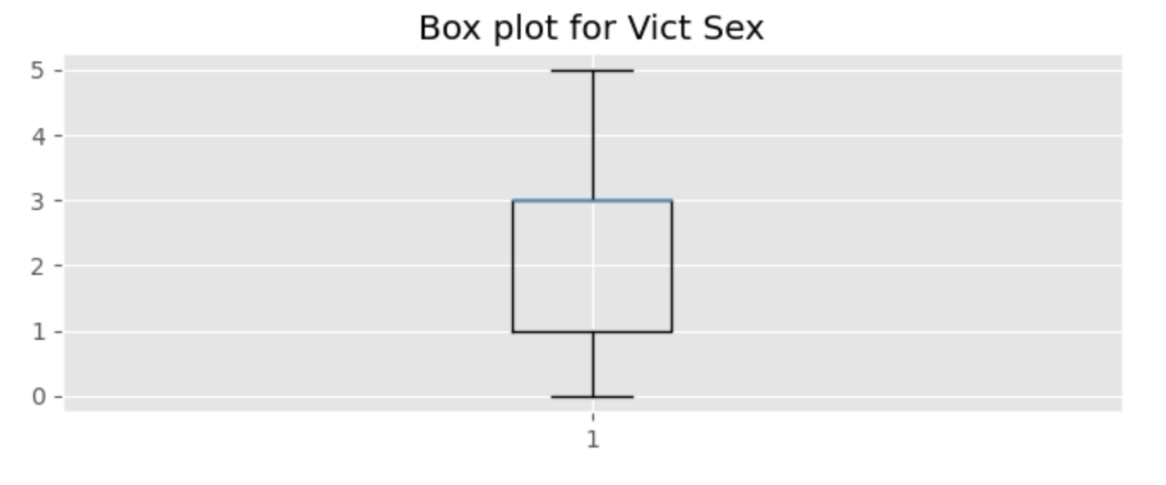
3. VISUALISATION
1. Finding anomalies and outlier using Interquartile Range (IQR) Method.
2. Finding anomalies and outlier using Z-score method.
3. Finding anomalies and outlier using box plots.

Slide 45
4. CONCLUSION
Despite handling null and missing values, outliers and anomalies are found.
The following are some typical causes of anomalies:
Human error in data entering: Errors in data entry can cause abnormalities.
Measurement errors: Outliers may be the consequence of inaccurate measurements or malfunctioning sensors.
Processing errors are mistakes that happen during the processes of gathering or processing data.
Although managing missing values in columns is crucial for maintaining data cleanliness, it does not ensure that there are no abnormalities in the dataset.
The techniques I previously discussed are utilized to identify and display anomalies or outliers in the data, including z-score, IQR, and visualizations. Even when the values are absent.

Slide 46
Problem Statement 9:
Analyze the dataset to identify any patterns or correlations between demographic
factors (e.g., age, gender) and specific types of crimes

Slide 47
Data Acquisition
Downloaded Crime data from https://data.lacity.org/Public-Safety/Crime-Data-from-2020-to-Present/

Slide 48
Data Inspection and cleaning part-1
Load CSV data provided.
Group data by required column 'Vict Age.',’Vict Sex’,’Vict Descent’ and ‘Crm Cd Desc’
Data types were converted i.e. numerical values to appropriate numerical types.
Top Ten most Specific types of Crimes were filtered out.
Five Top descents of victims were filtered out.

Slide 49
Data Inspection and cleaning part-2

Slide 50
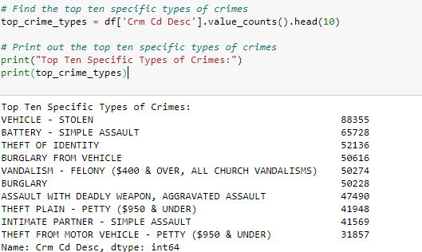
Data Inspection and cleaning part-2

Slide 51


Visualizations Code part 1

Slide 52

Visualization Code part 2

Slide 53


Visualizations Part1

Slide 54

Visualizations part 2

Slide 55
Conclusion
Across all visualizations, it's evident that certain demographics, whether based on age, descent, or gender, have higher affiliations with particular types of crimes.
This information can be crucial for law enforcement agencies and policymakers to tailor prevention and intervention strategies more effectively.
The data showcases discernible patterns across age, descent, and gender in relation to specific crimes, emphasizing the need for targeted intervention strategies based on demographic trends to effectively address and prevent criminal activities.

Slide 56
Problem 10
Employ time series forecasting methods, such as ARIMA or Prophet, to predict future crime trends based on historical data. Consider incorporating relevant factors into your models.

Slide 57
Data Acquisition Inspection and cleaning
Downloaded Crime data from https://data.lacity.org/Public-Safety/Crime-Data-from-2020-to-Present/
Convert the 'DATE OCC' column to a datetime object
'Date Rptd' column to was converted to datetime
Crime count was calculated based on 'Crm Cd Desc'.

Slide 58
Data Inspection and Cleaning part 2:

Slide 59

Code for Data Cleaning

Slide 60

Visualization codes

Slide 61


Visualizations

Slide 62
Conclusion
There are discernible variations in crime rates between 2020 and 2023 according to historical crime data. Peaks can be seen in early 2021 and mid-2022, with a notable decline in 2023.
According to the ARIMA estimate, there should be little fluctuations in the crime rate between 2023 and late 2024, keeping it relatively steady.
Based on historical trends, this estimate suggests that crime rates may stabilize in the following months. While external circumstances may still bring about unforeseen changes, policymakers and law enforcement organizations can use this prognosis to coordinate resources and plans.

